Slide 1
NCSTA Distinguished Service in Science Education in a Non-school Setting
Tanya Poole, Regional Education Specialist for the N.C. Wildlife Resources Commission

Slide 2
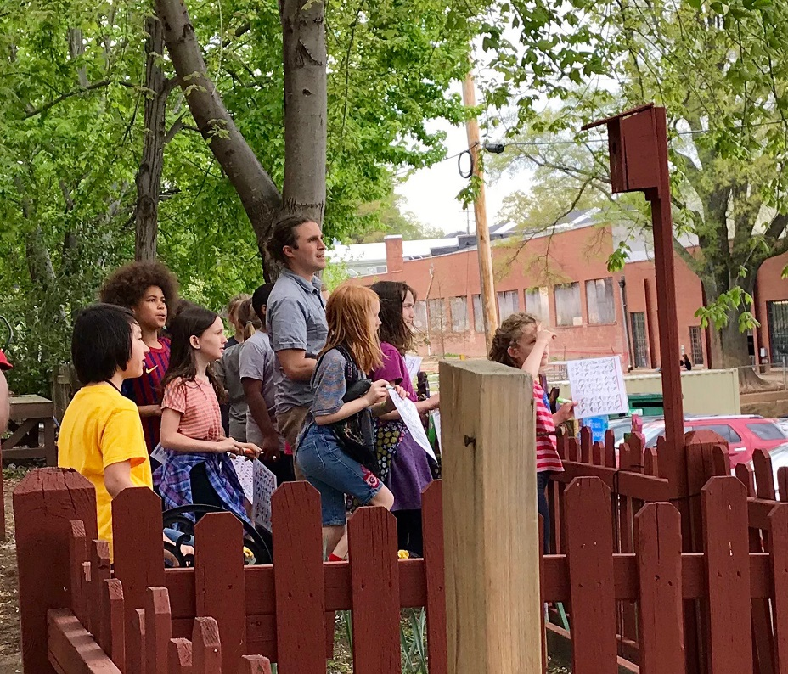
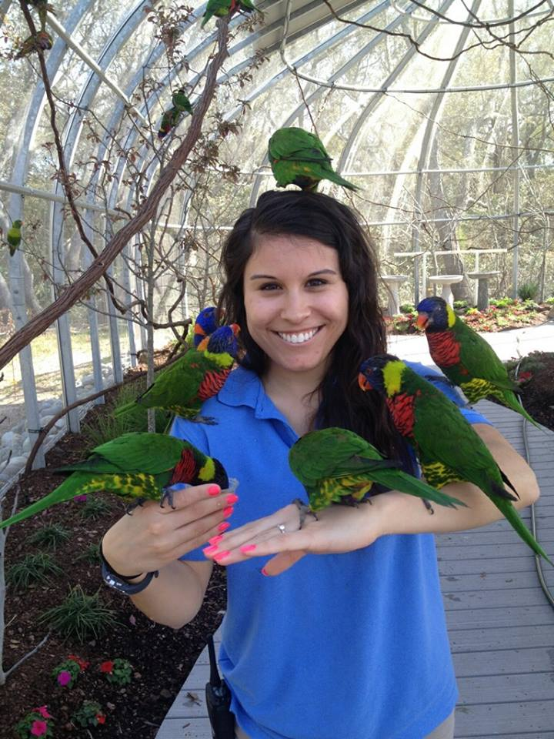
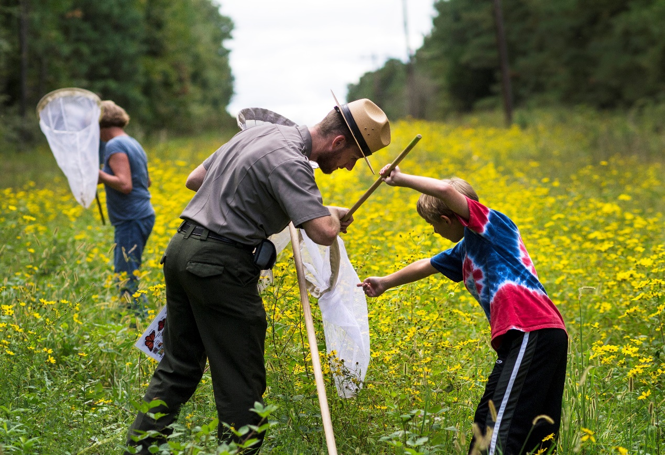
Office of Environmental Education and Public Affairs

Slide 3
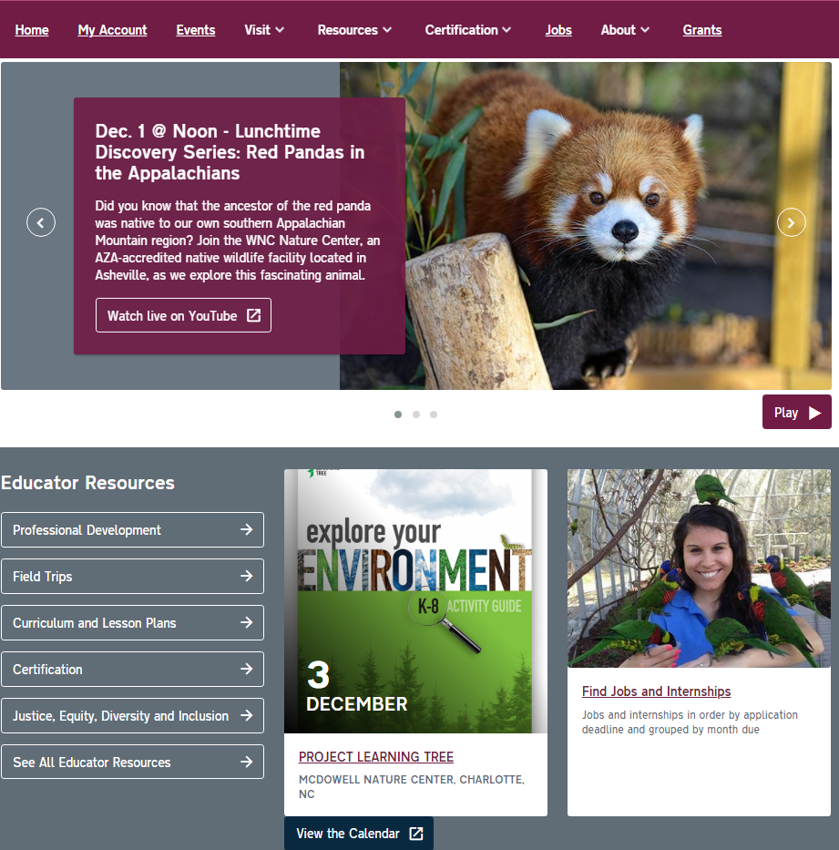
Get Connected!
Promote Your Programs
Join the NC Environmental Education Listserv – promote your workshops, outdoor experiences, internships, jobs and grants. 3,500+ subscribers Sign up for Teachable Moments Blog – submit feature stories on projects and educators
Follow us on Facebook and Twitter
Update your facility’s profile

Slide 4
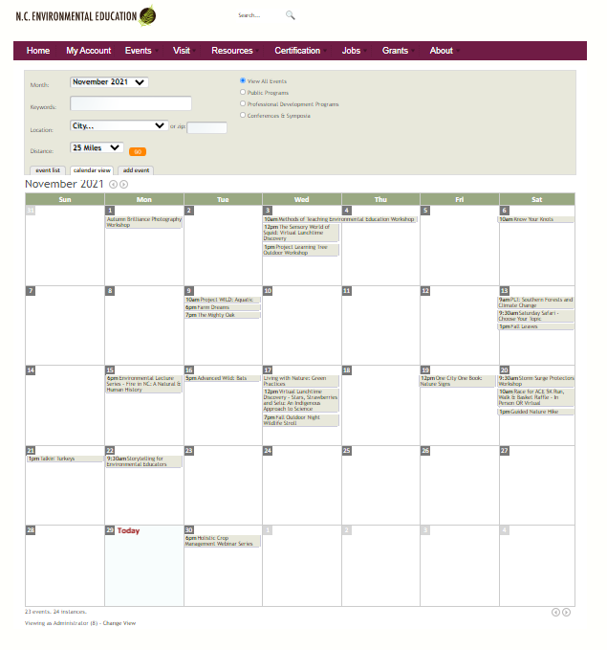
Updates to Resource Database and Calendar of Events

Slide 5
