Slide 1
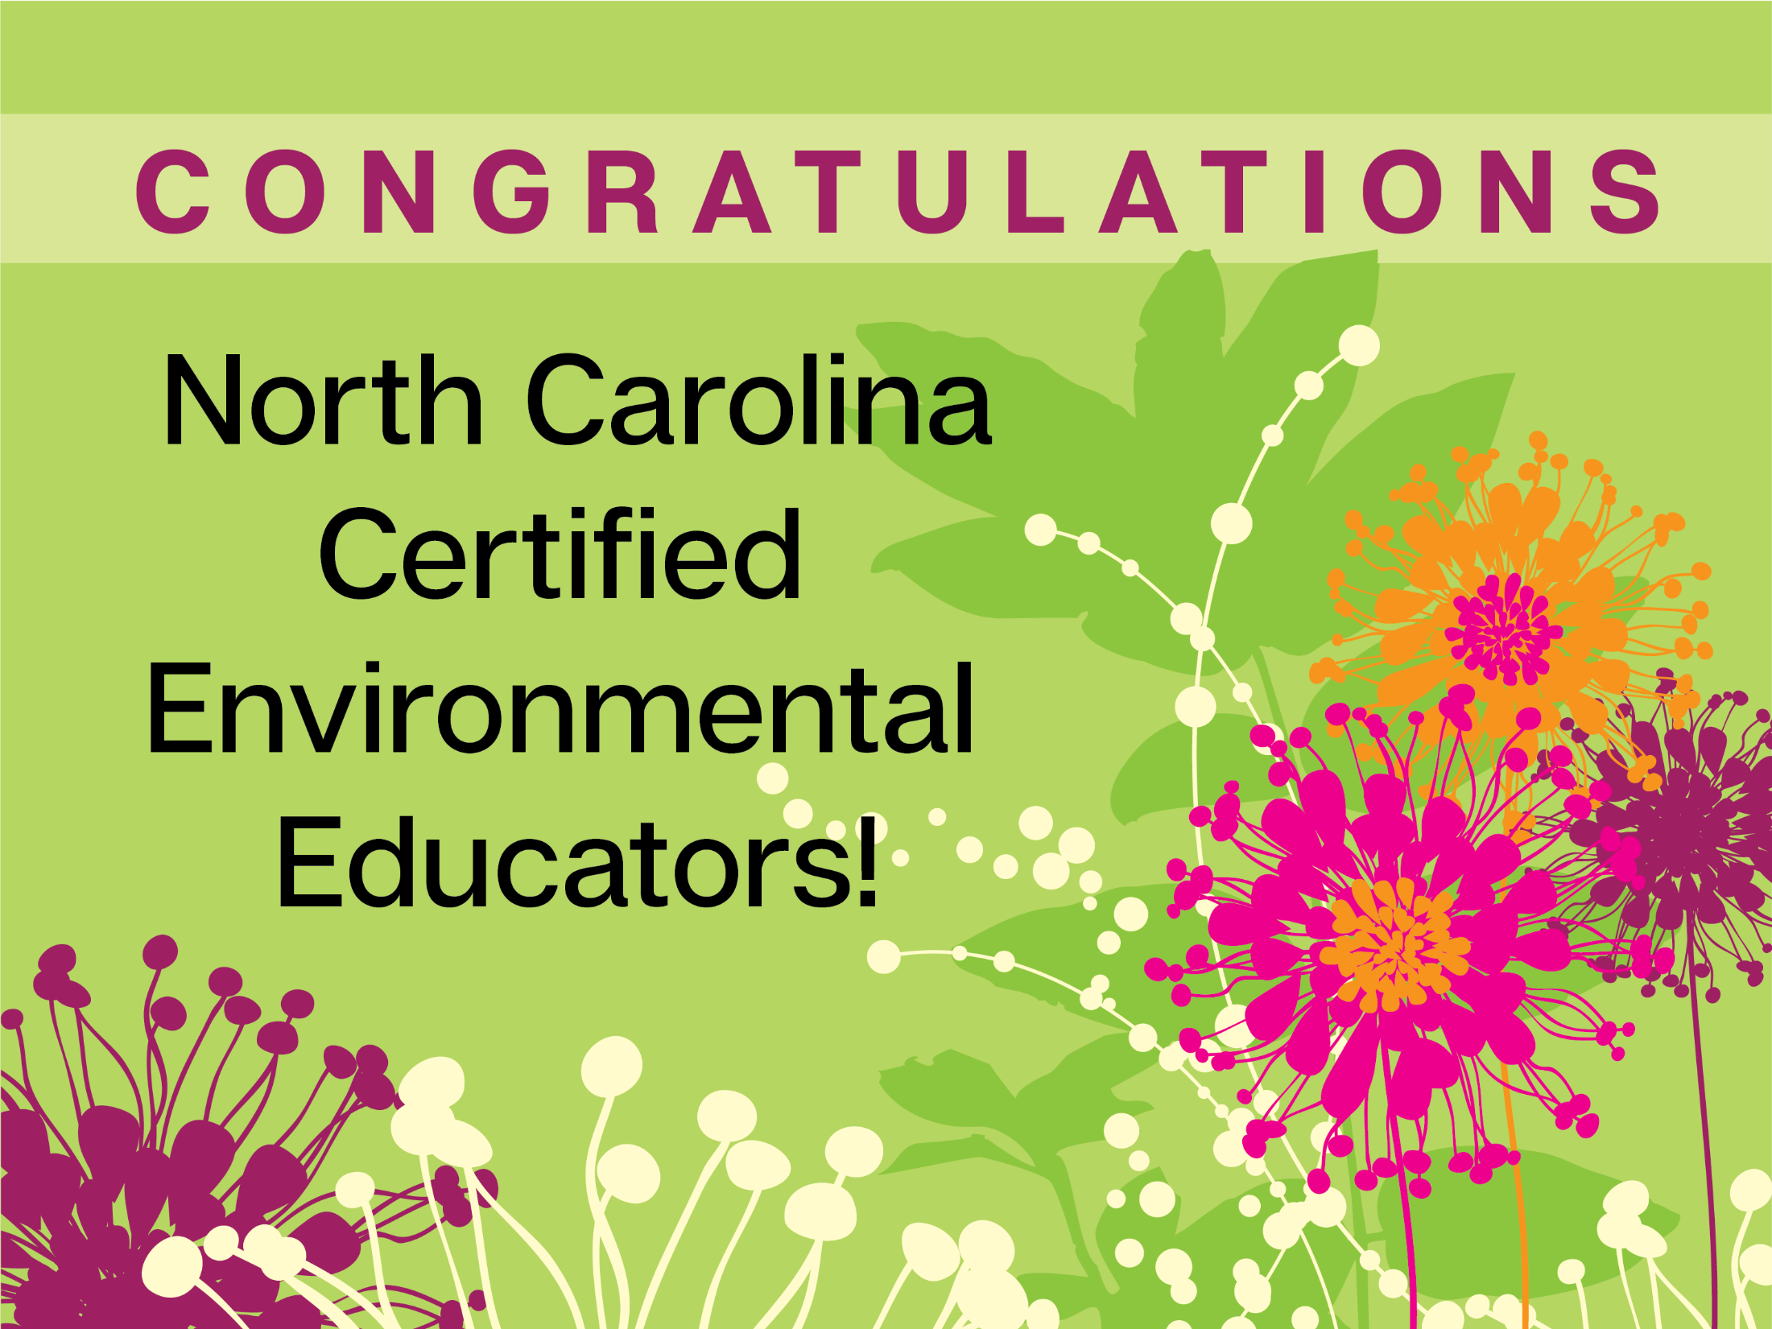

Slide 2

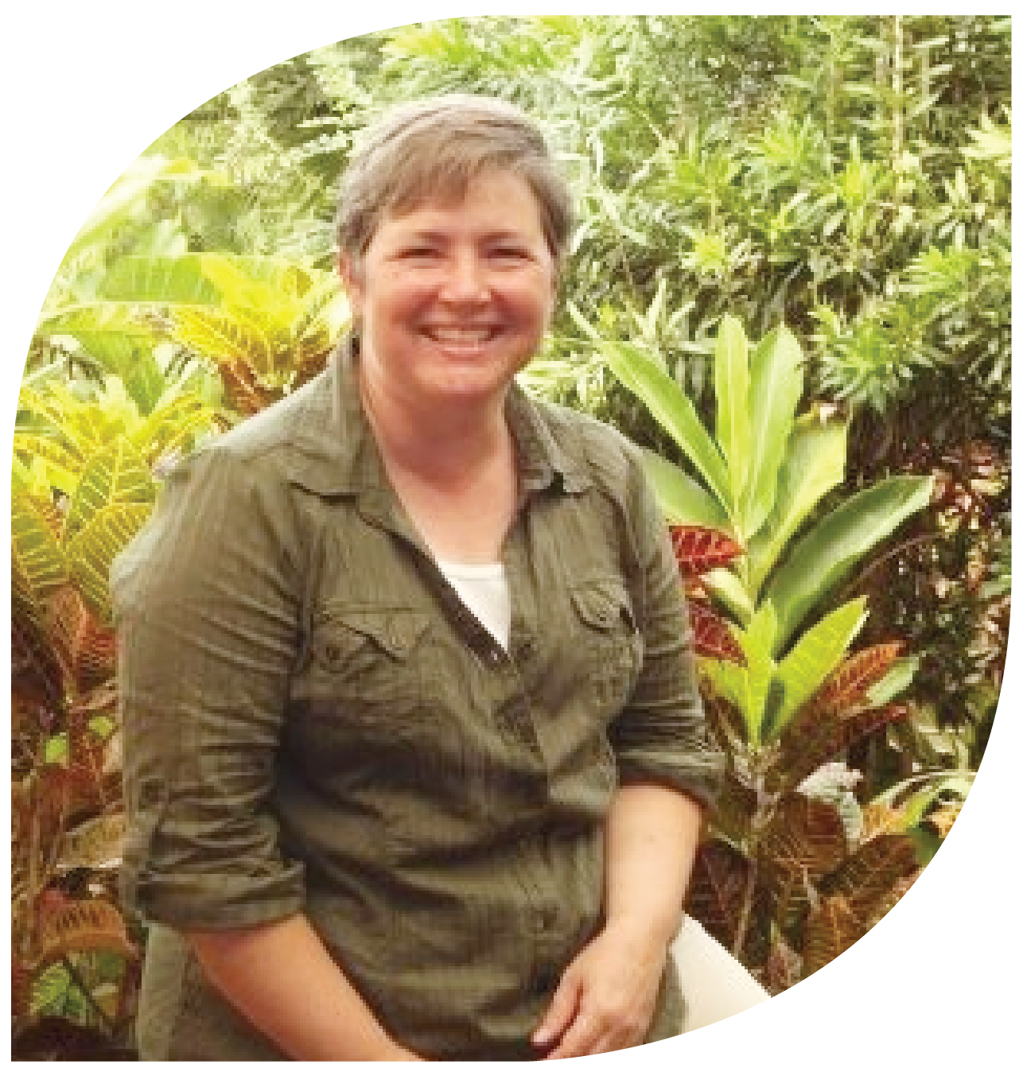
My depth of knowledge about wildlife, geography and history grew abundantly as we were immersed in the sites and sounds of our own state. These experiences built my confidence and gave
me strategies that I can
use with my own students.
I am so grateful for this
program, and hope that I can continue to inspire my students
to explore the outdoors. Cheryl michalec
Durham Public Schools

Slide 3
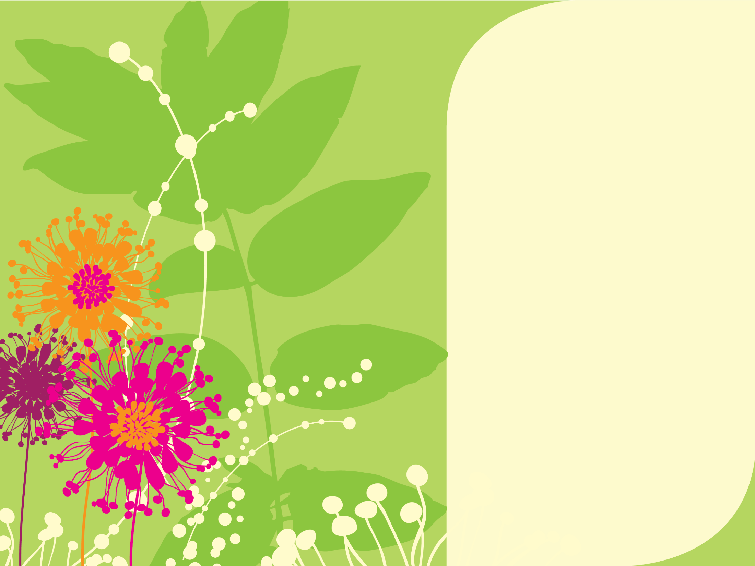
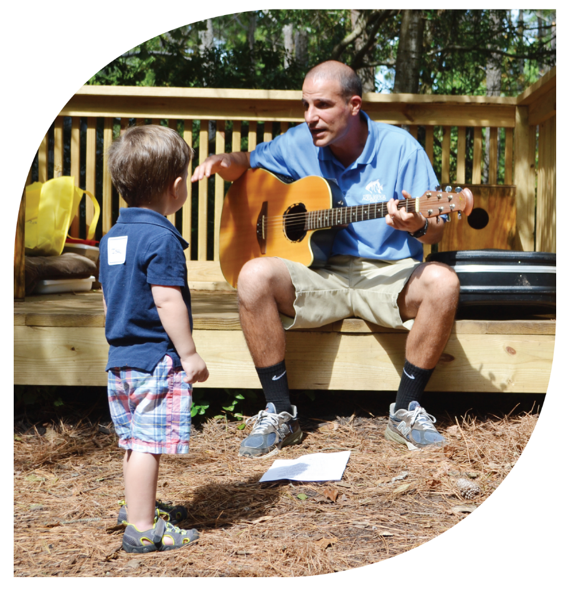
I’ve been an environmental educator since 2004, but I was new to North Carolina as of 2015. The certification program provided me a wonderful opportunity to become acquainted with the people and the wild places that make being an environmental educator in North Carolina so special.
Paul mazzei
NC Aquarium on Roanoke Island

Slide 4
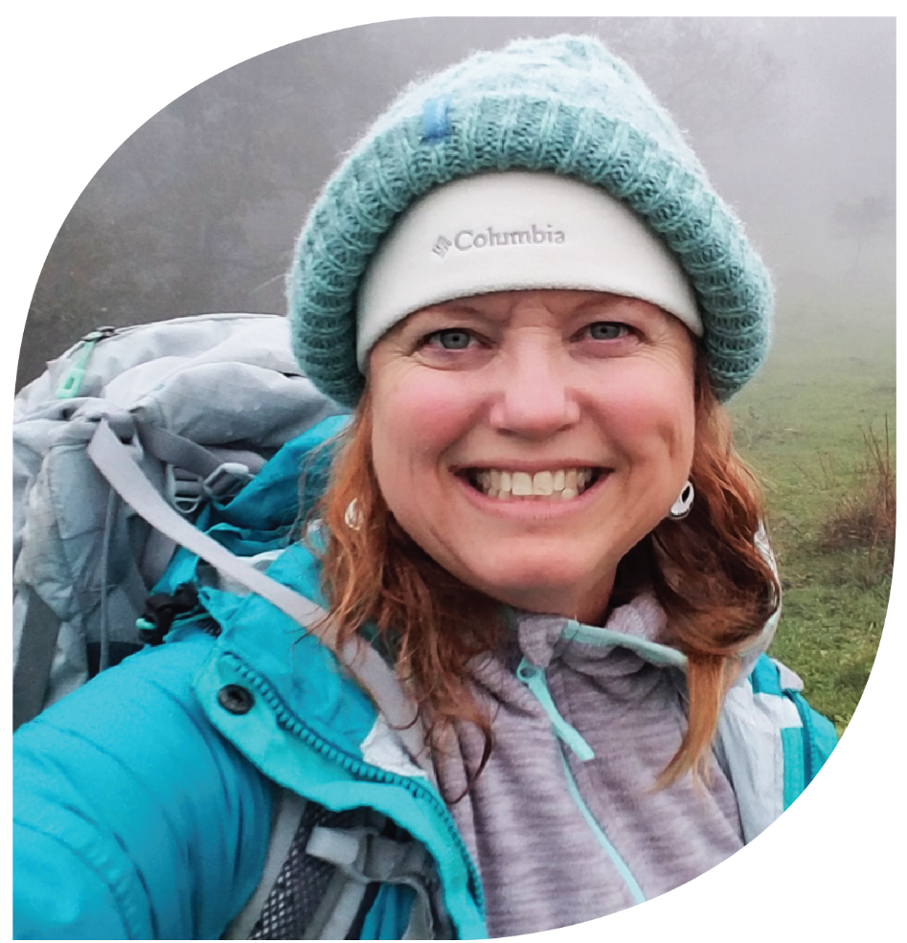
I’ve seen, traveled, and discovered more of our state
during this program than I
have in my 30+ years of
living here. Everything I’ve
learned and all the
resources I’ve gained
have tremendously
improved my teaching
and allowed me to
spread awareness of
environmental education
to children and adults alike.
Rebecca Masters
Elizabeth City-Pasquotank Public Schools

Slide 5
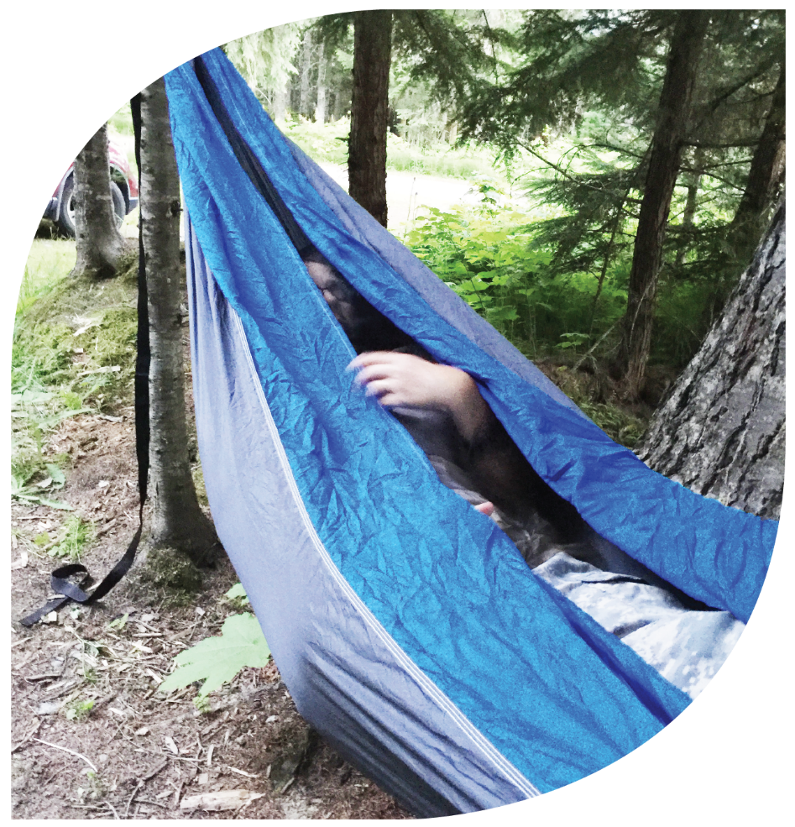
The best part of earning my certification was learning how to fish—in the surf, from a pier,
and from a kayak. Thank you
very much to Becky Skiba from
the NC Wildlife Resources Commission and Gerald Klauss
from the John E. Pechmann
Fishing Education Center.
Julia little
Westover High School Science

Slide 6
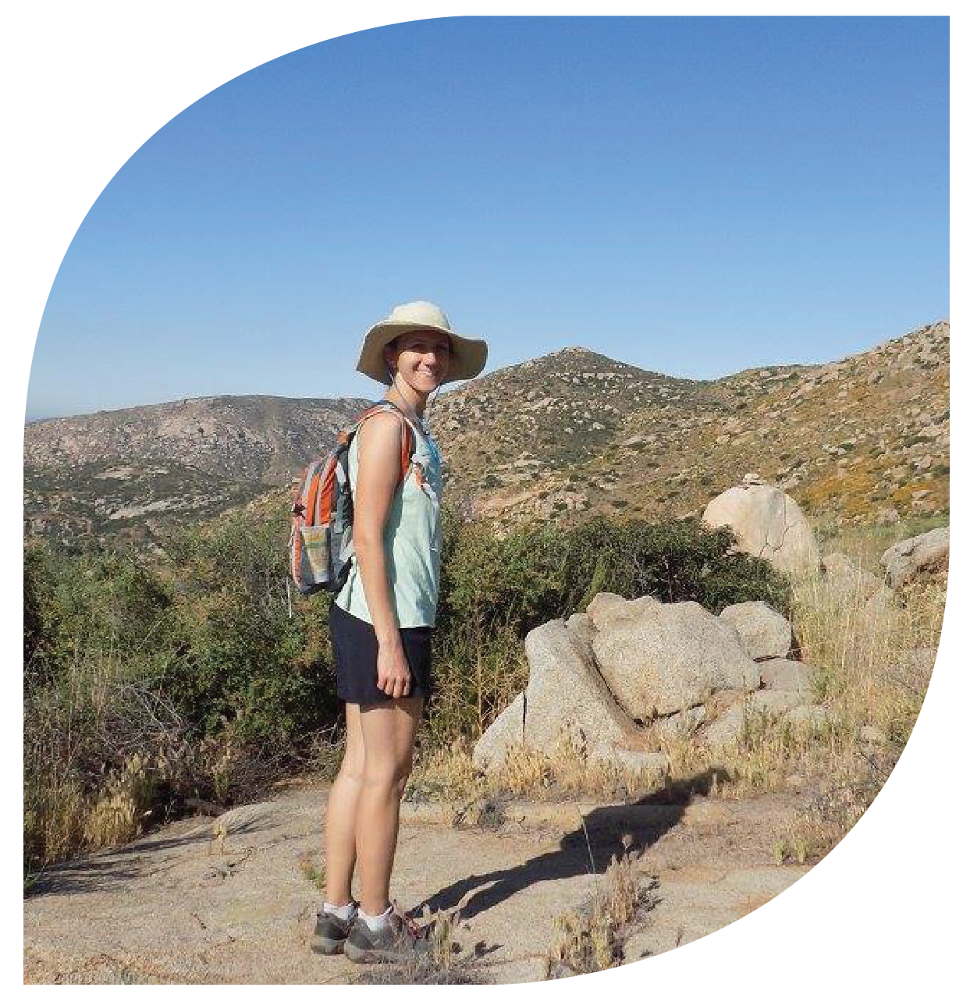
The NC Environmental Education Certification program offered me inspiration and many wonderful learning experiences. The program challenged me
to keep learning and expanding my horizons
on topics I otherwise may
not have encountered.
emilee morrison
NC Cooperative Extension

Slide 7
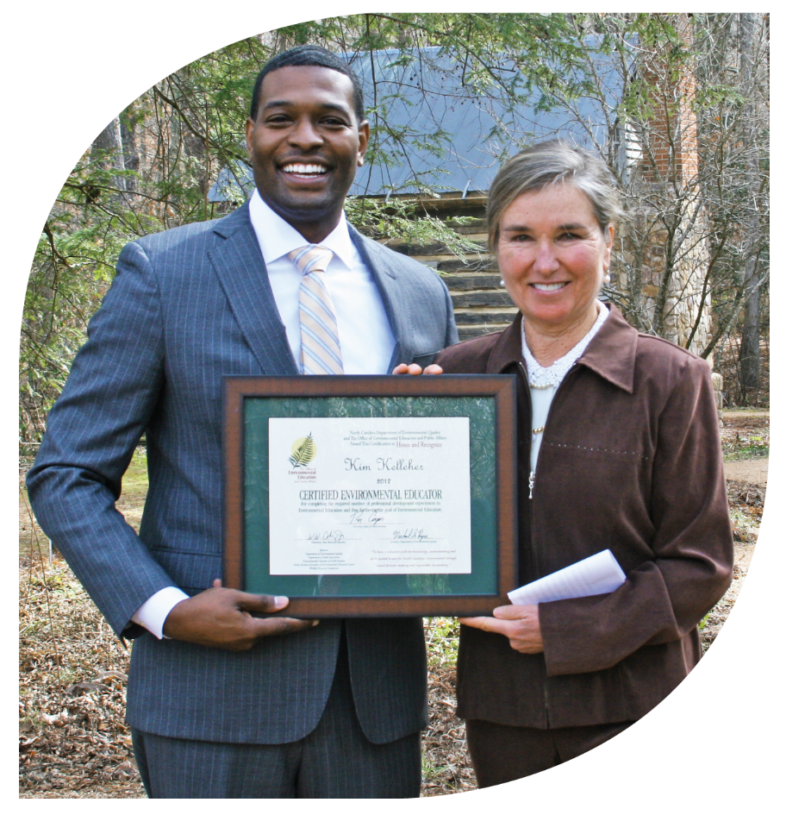
I have been a school counselor for the last 40 years. Combining these skills with my newly acquired Environmental Education Certification allowed me to engage the students who were struggling to learn
in the traditional classroom
by taking them outside.
Kim Kelleher
Orange County Schools

Slide 8
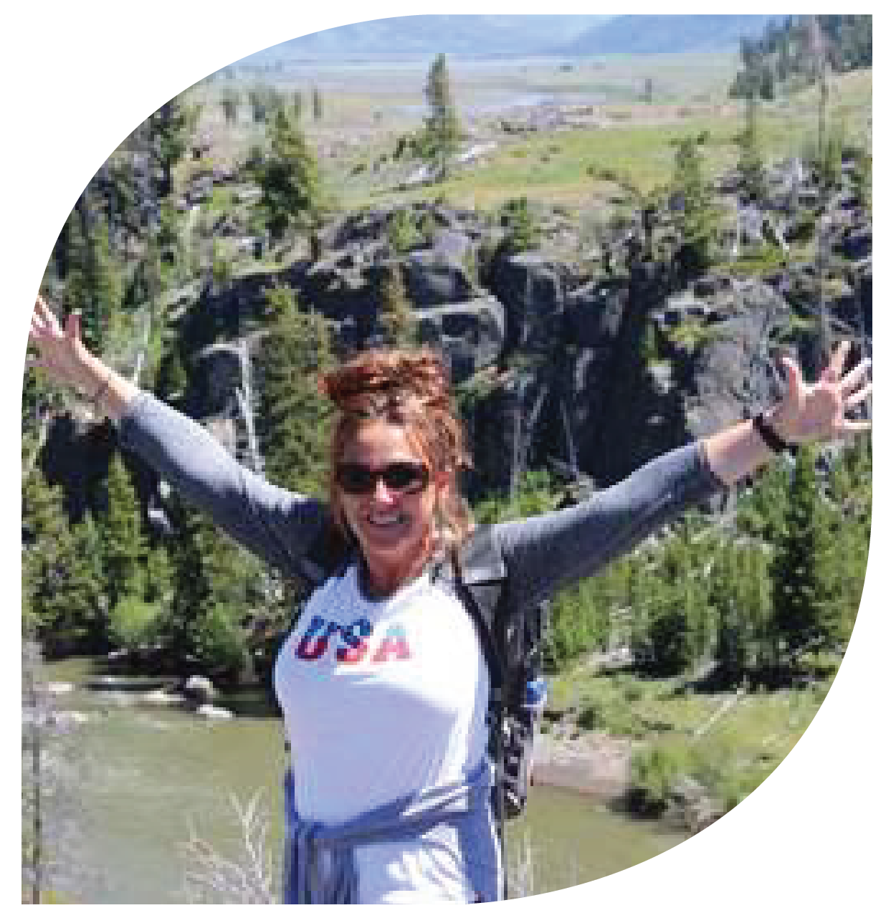
With gratitude and enthusiasm I teach our youngest explorers about the wonders of our natural world. Completing my Environmental Education Certification has
sparked a new flame, a
new passion to travel,
to share, to question
and to wonder alongside
my kindergarten students.
The environment is my
co-teacher.
Renee pagoota-wight
Catawba County Schools

Slide 9
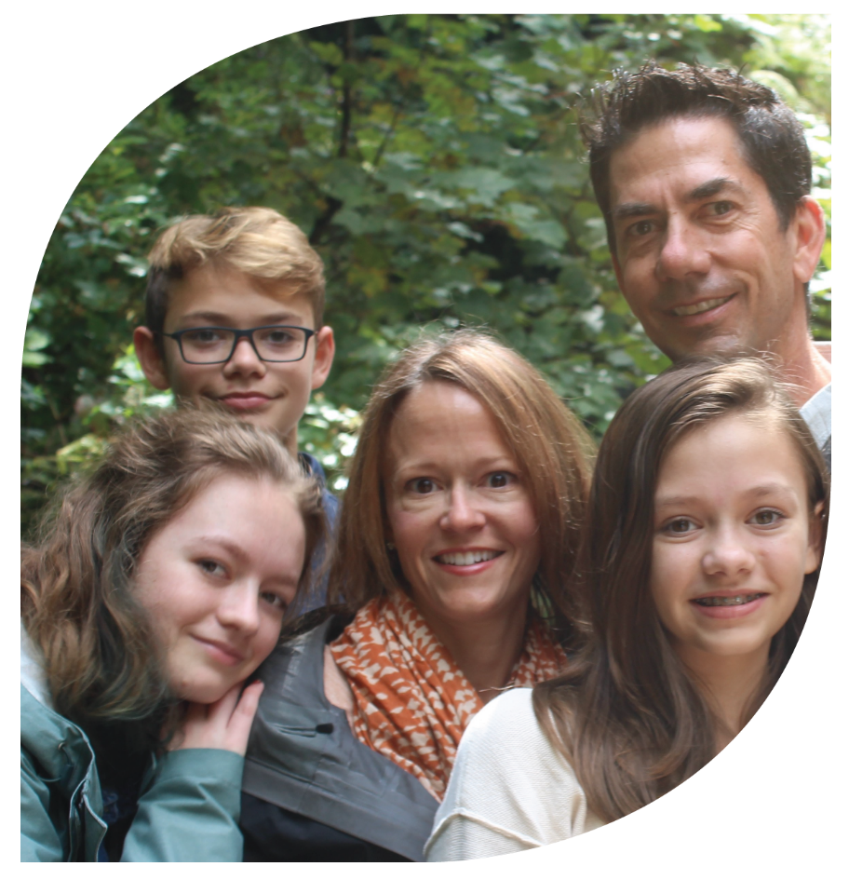
Thank you so much for offering this opportunity for me to continue sharing nature education with students. I have thoroughly enjoyed the journey.
Tracey dranttel
Wake County Public Schools

Slide 10
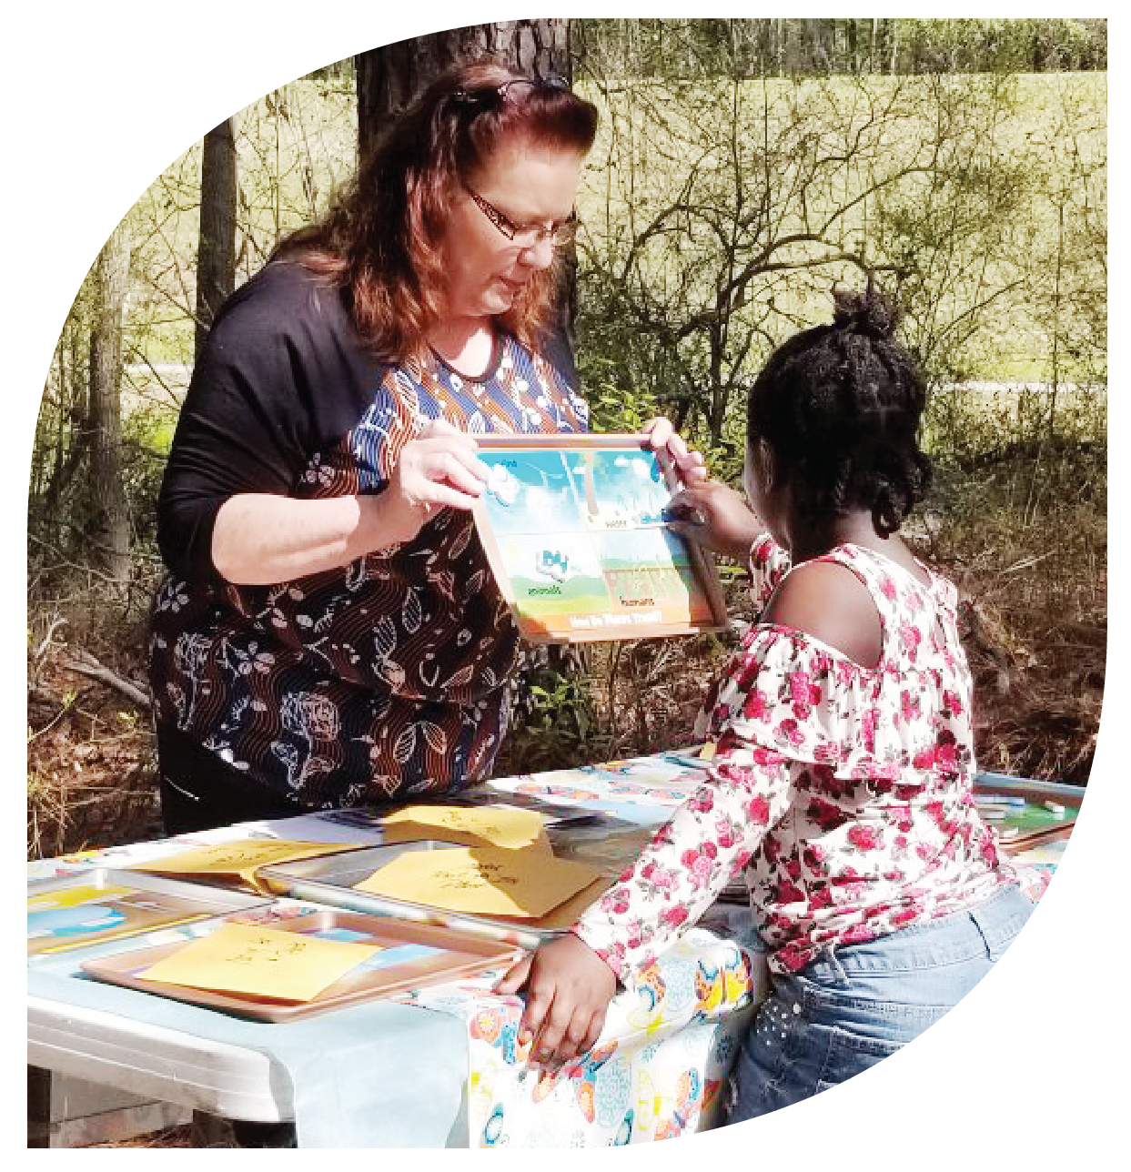
The Environmental Education Certification program has definitely given me more confidence to teach environmental education.
I have learned to
make it fun as well
as informative.
Gretta steffens
Sampson Soil and Water Conservation District

Slide 11
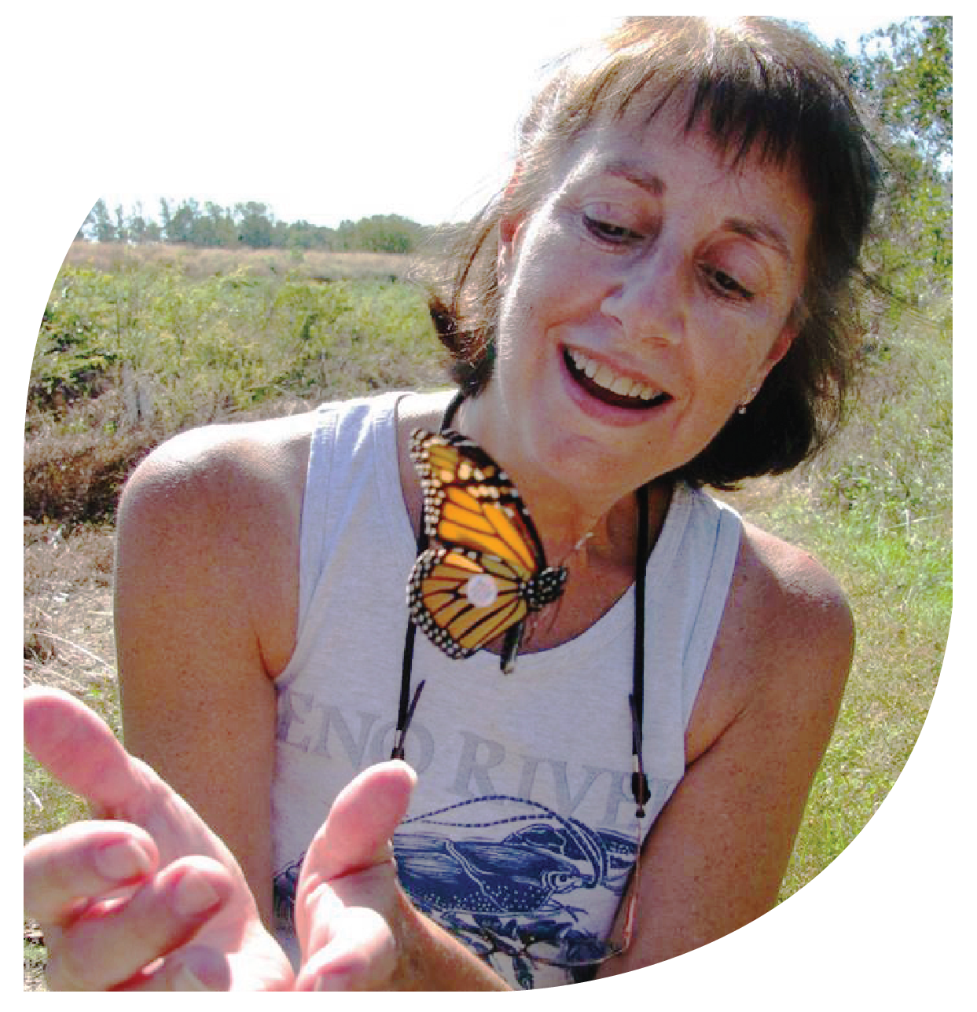
I take my volunteer job as citizen scientist and outreach educator very seriously – it is the most
fun I have ever had! Thank
you for providing
knowledge, experience
and confidence.
Sandy durso
NC Museum of Natural Sciences
NC Herp Society

Slide 12
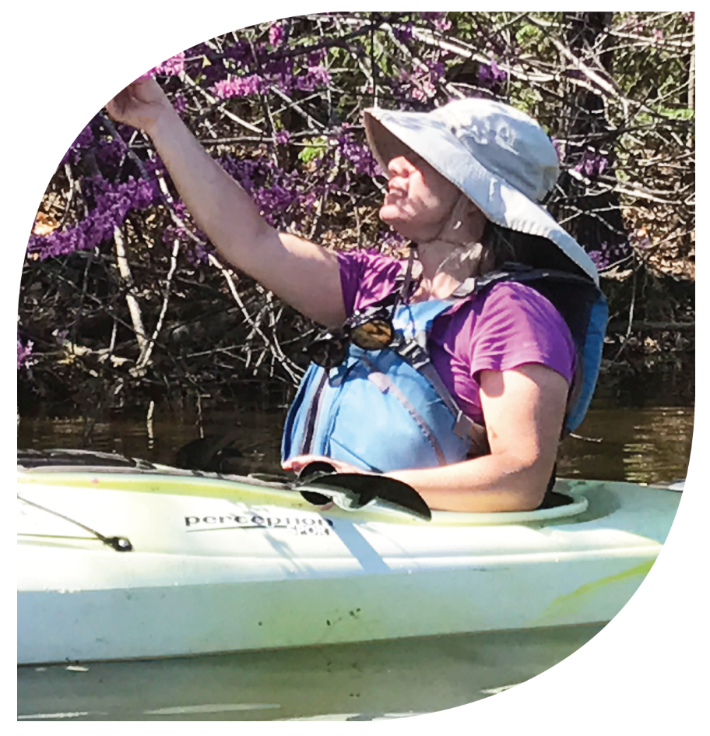
It was inspiring to meet the passionate and dedicated people who share their knowledge and expertise every day to educate people about North Carolina’s unique environment.
Dale morgan
Chapel Hill Public Library

Slide 13
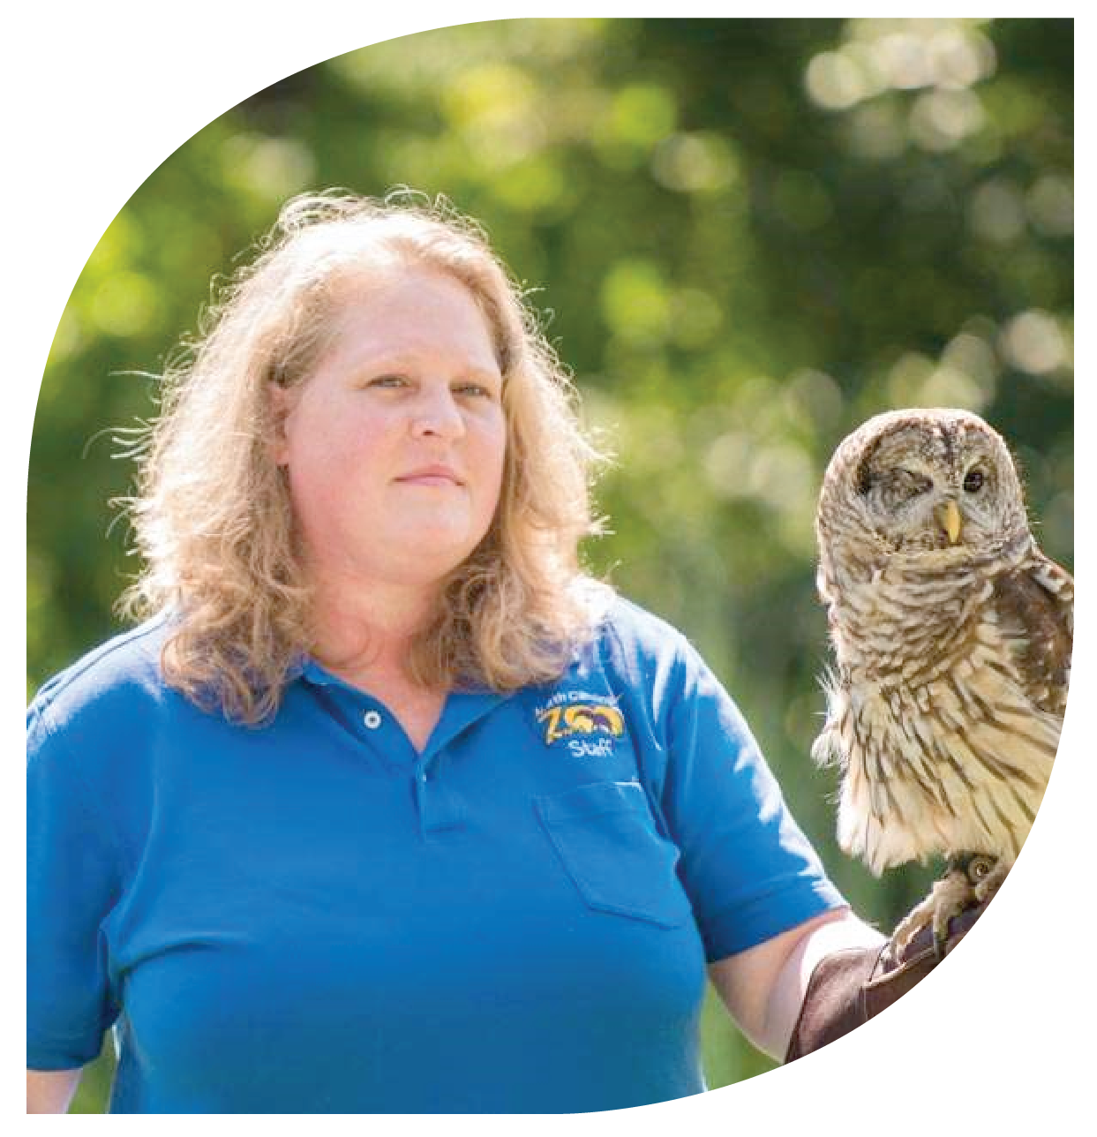
This program is amazing! I enjoyed all aspects of the certification program, it got me all over
the state visiting places
I may never have visited
on my own. The variety of
topics to choose from was wonderful and I learned so
much and had fun doing it!
Nicole petersen
North Carolina Zoo

Slide 14
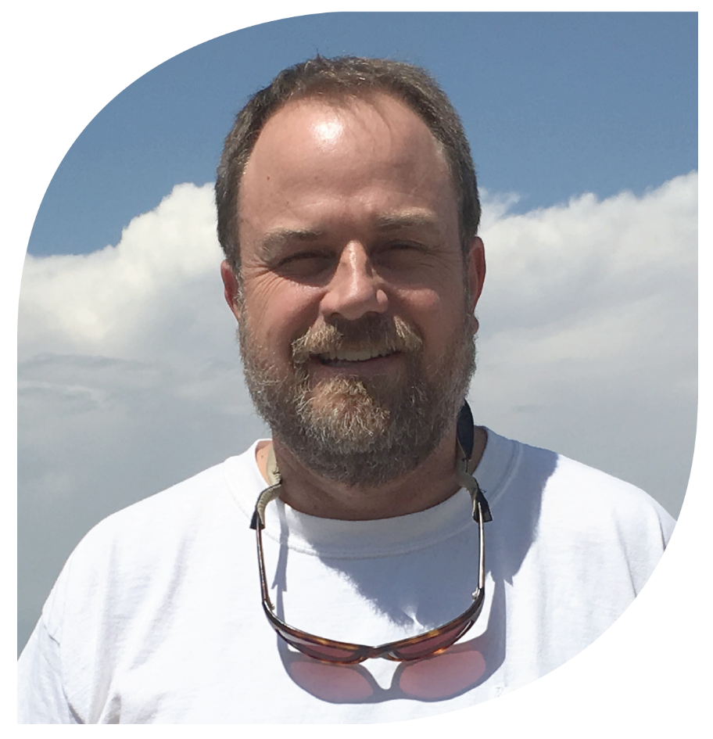
Learning the various flora and fauna, and visiting parks and nature centers throughout the state of North Carolina has expanded my knowledge and encouraged me to continue exploring these subjects.
brad Williams
River Park North
Walter L. Stasavich Science & Nature Center

Slide 15
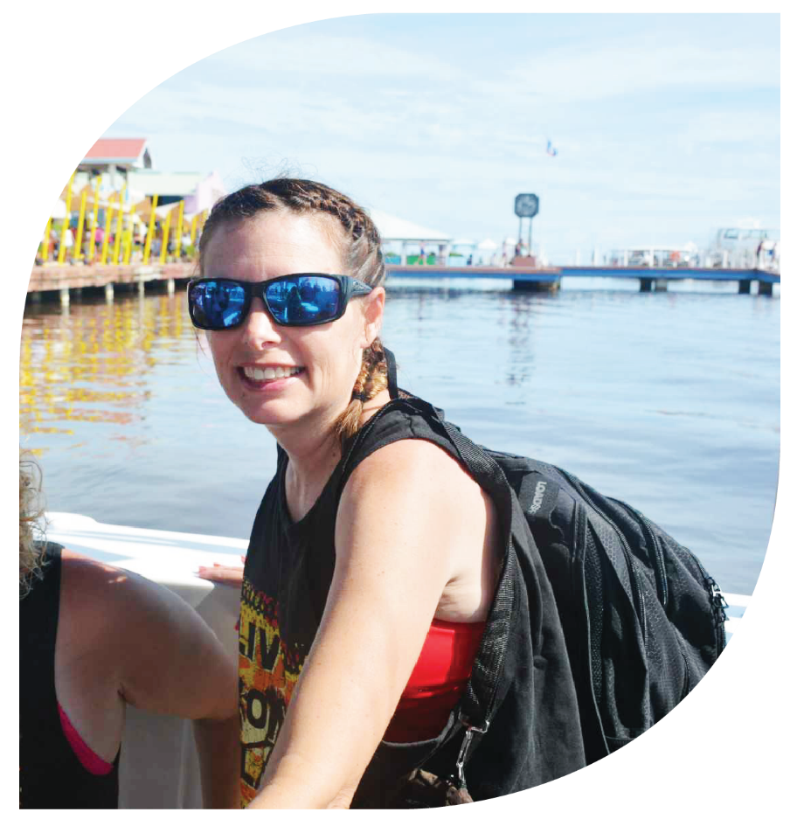
The more hours I spent attending environmental education coursework, the more I realized how much I did not know about my environment. The knowledge is never ending and continually evolving. Comprehending how nature is interconnected between plant phenology, animal life cycles, insects, bats, snakes and tidal waves was so eye opening.
Kelli sullivan
Volunteer

Slide 16
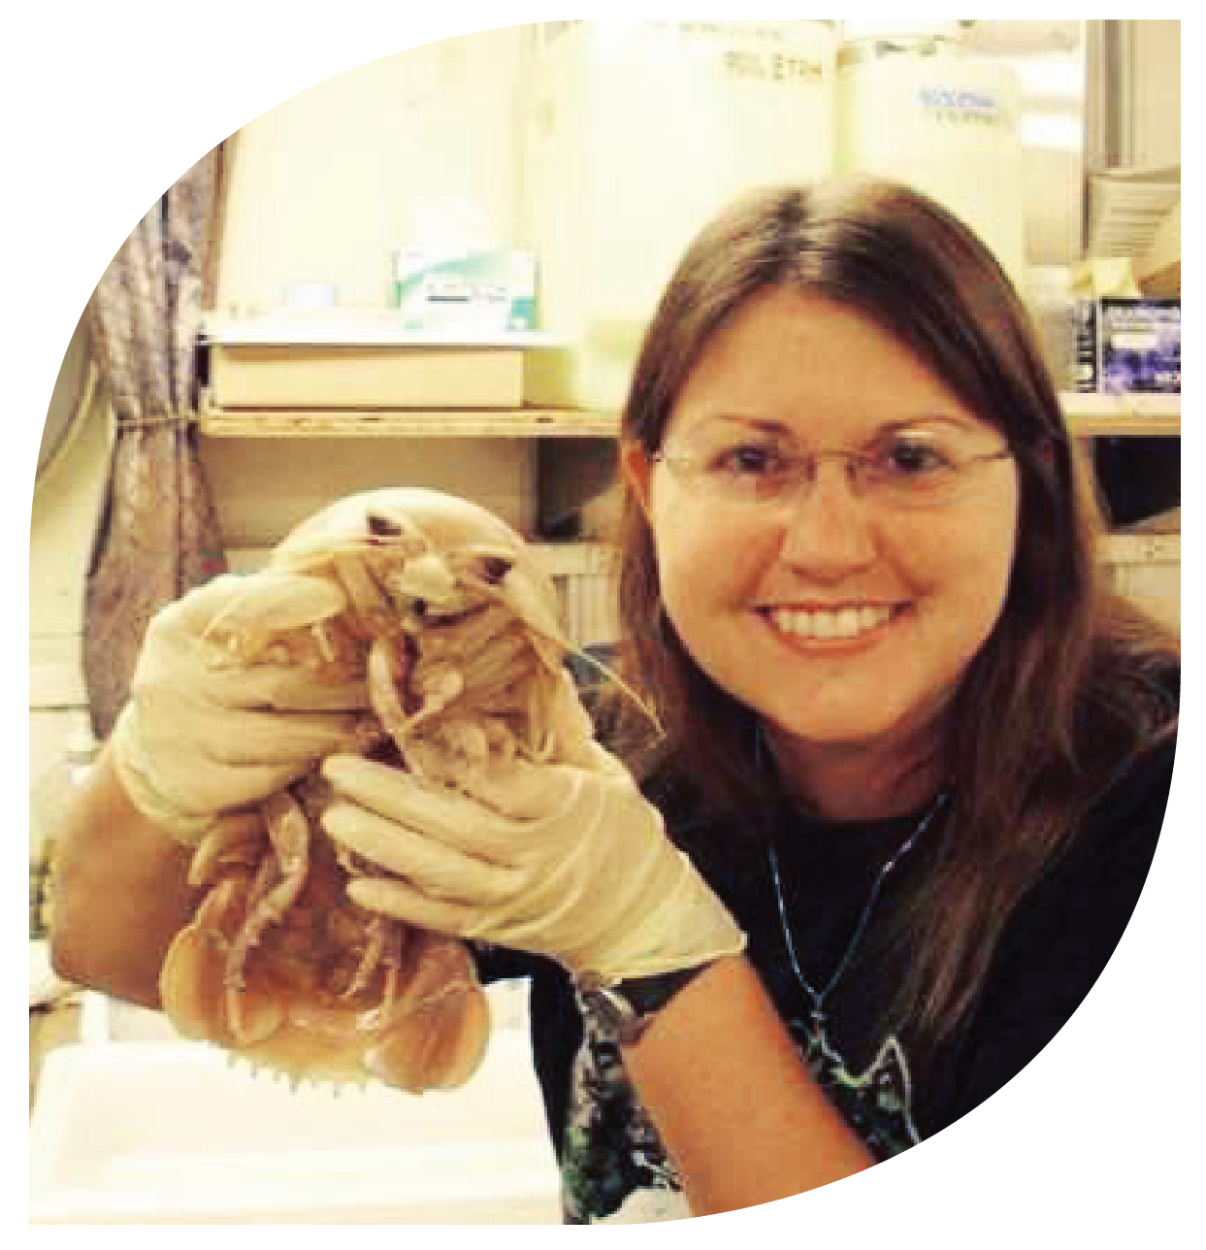
The certification program provided a platform for collegial conversations in respect to environmental stewardship and student engagement. I am so appreciative to the staff who assisted me in finding coursework
in my area so I could complete
my certification. I am proud and honored to be a part of the environmental education
community in North Carolina!
Beverly owens
Kings Mountain Middle School

Slide 17
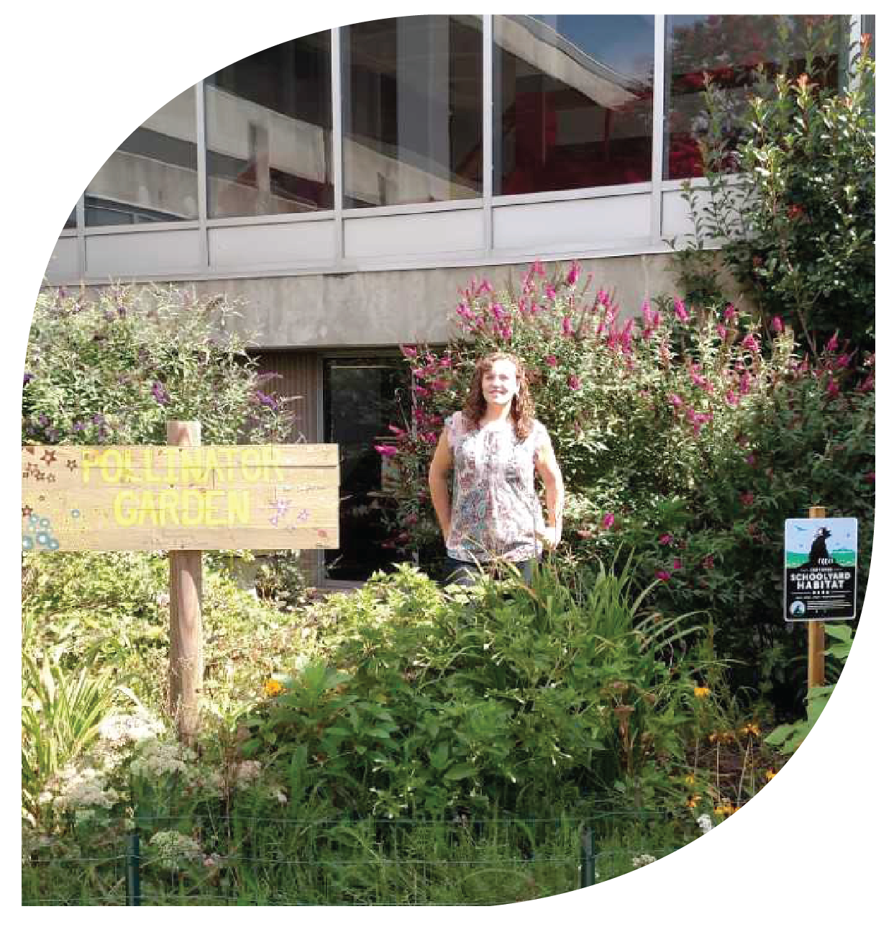
Becoming a certified environmental educator gave me the knowledge and experience to better integrate environmental literacy and ecological stewardship into
my traditional science
classroom. Completing the
community project for my
certification inspired me to
develop a pollinator garden at
my high school.
Lily dancy-jones
Erwin High School

Slide 18
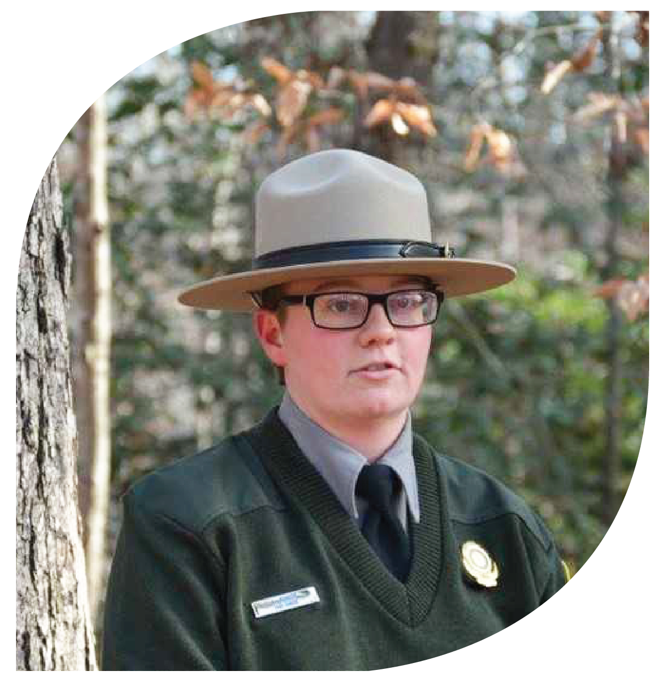
Earning my certification helped to change the way I view many environmental issues. There are a myriad of sides to every issue and going through this certification process helps you to understand the science content behind the issue and
then helps develop the people skills to be able to talk about varying viewpoints.
Lindsey baker
Raven Rock State Park

Slide 19
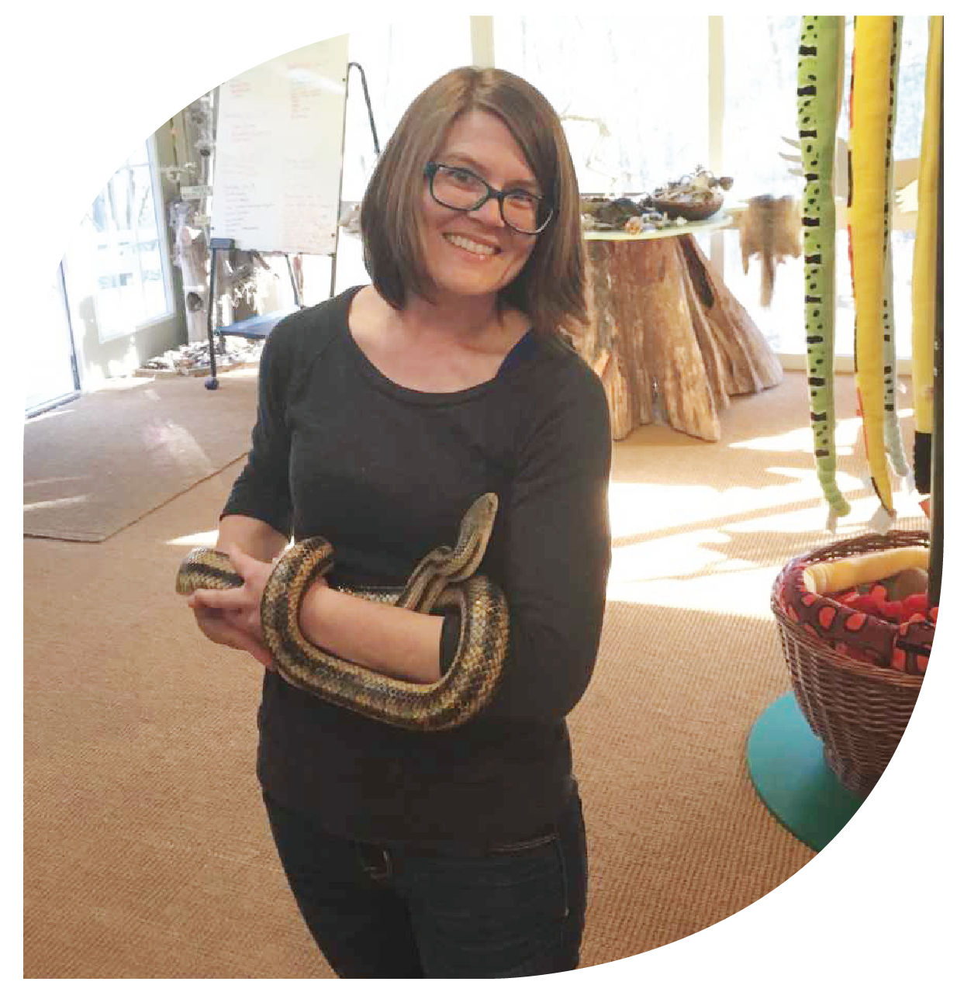
This program helped me gain confidence in my teaching, helped me grow professionally and personally, and guided me as
I moved from environmental regulation into environmental education.
Susan licher
Central Midlands Council
of Governments

Slide 20
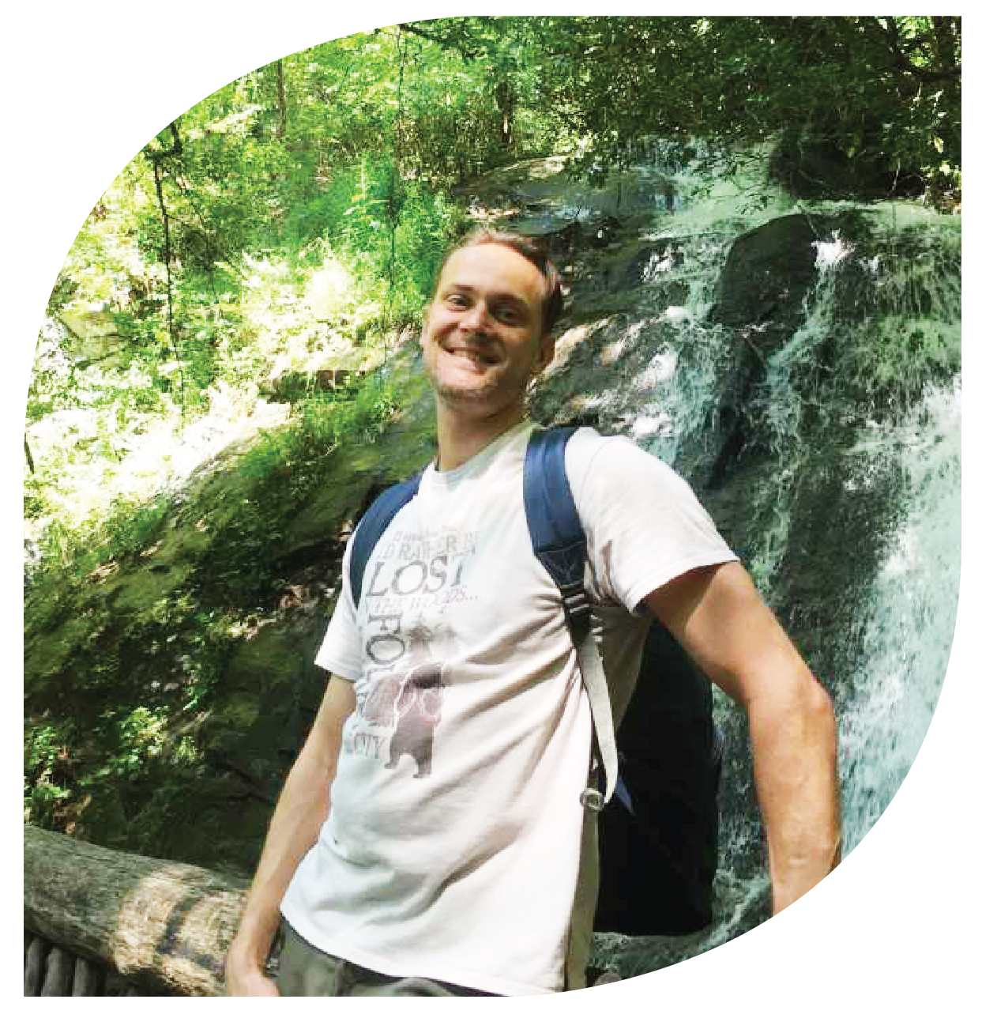
As a non-formal educator the Methods of Teaching Environmental Education class was the most impactful experience. This helped me strategize my communication and educational approach,
which can be summed up in
this haiku-inspired poem:
Start with awareness
Move with curiosity
To experience wonder.
Thomas slusser
NC Department of Environmental Quality

Slide 21
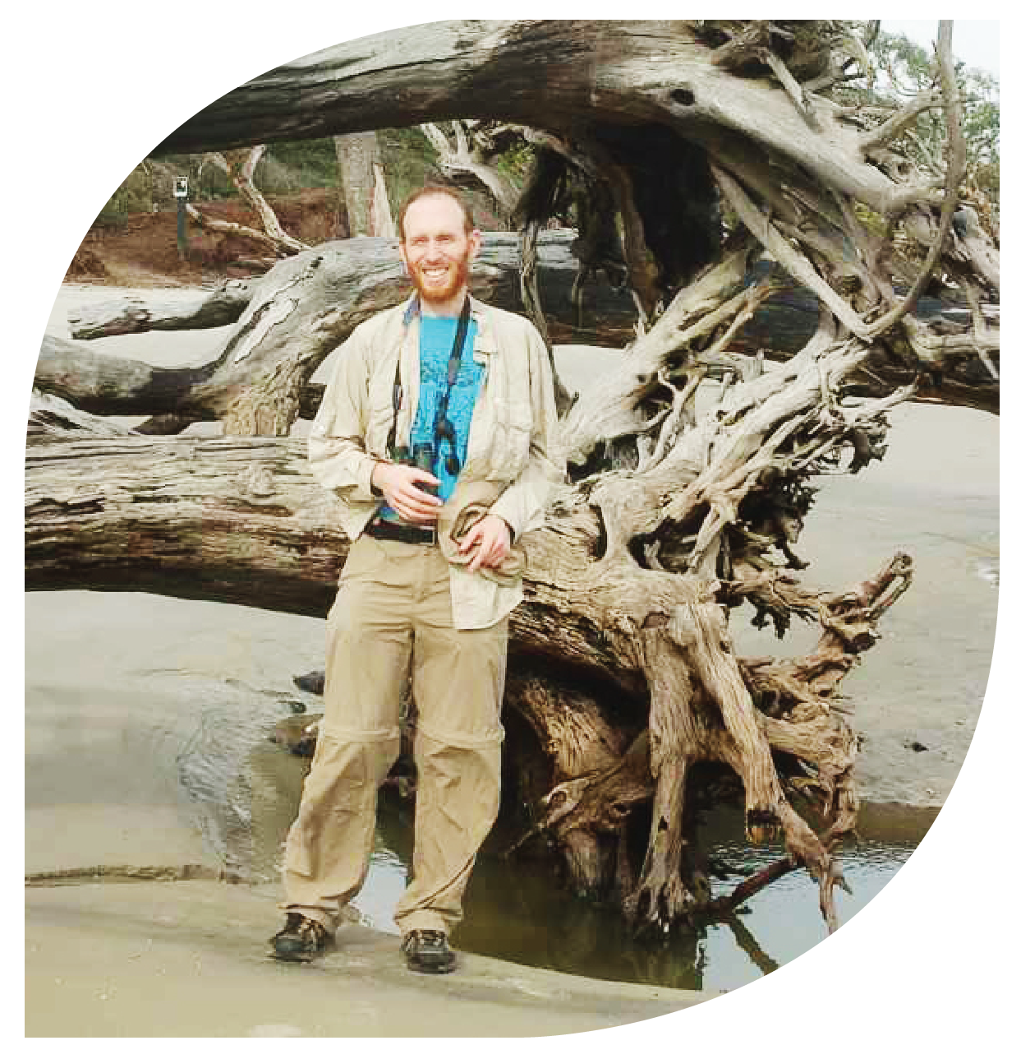
During each of the workshops and field experiences, it was amazing to spend time outside, learning ways to share the natural world
with like-minded people who love sharing it. I couldn’t think of a
better way to spend my time.
Tracy feldman
St. Andrews University,
A Branch of Webber International University

Slide 22
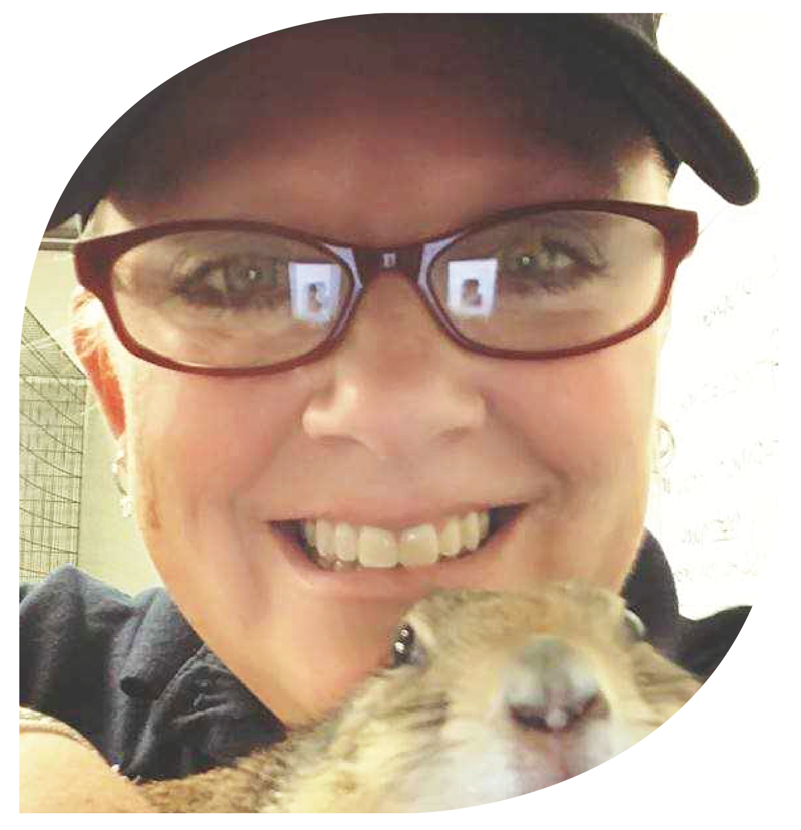
I have so enjoyed opening up my mind to new ways of learning and seeing the natural world from these certification workshops…as well as
learning from the people attending along with me.
There are always little pearls
of knowledge to be plucked
from each person you meet!
Wendy foley
North Carolina Zoo

Slide 23
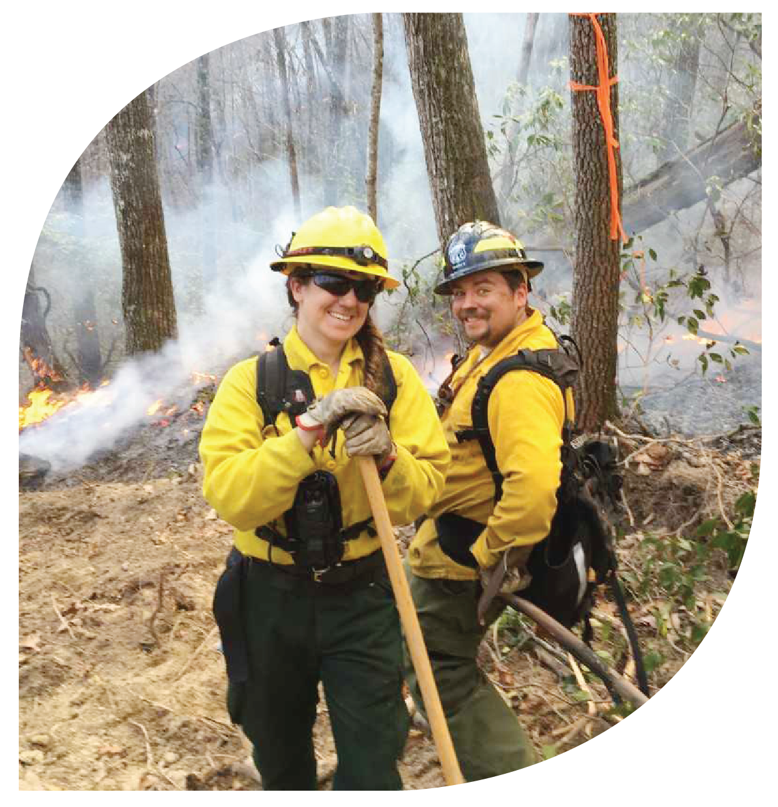
It’s nice to see other people just as passionate about providing a quality education program, and to brainstorm about the
program evaluation process for program offerings.
Amy kinsella
NC Forest Service

Slide 24
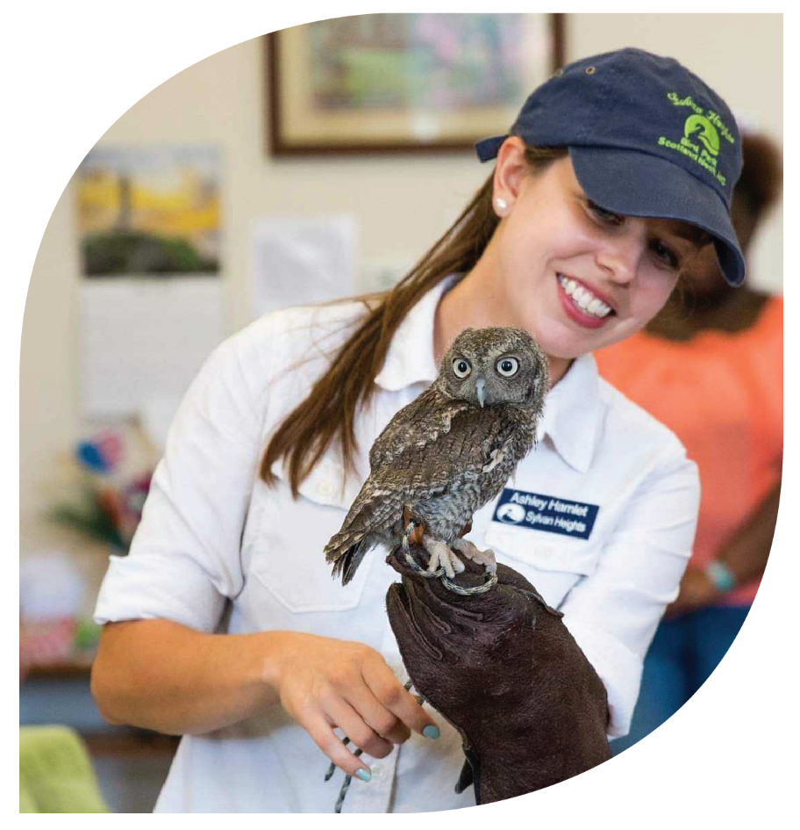
The certification program allowed me to grow personally and professionally. The program gave me the opportunity to travel the state, gain new skills as an educator, and meet a wonderful community
of fellow nature nerds!
Ashley hamlet
Sylvan Heights Bird Park

Slide 25
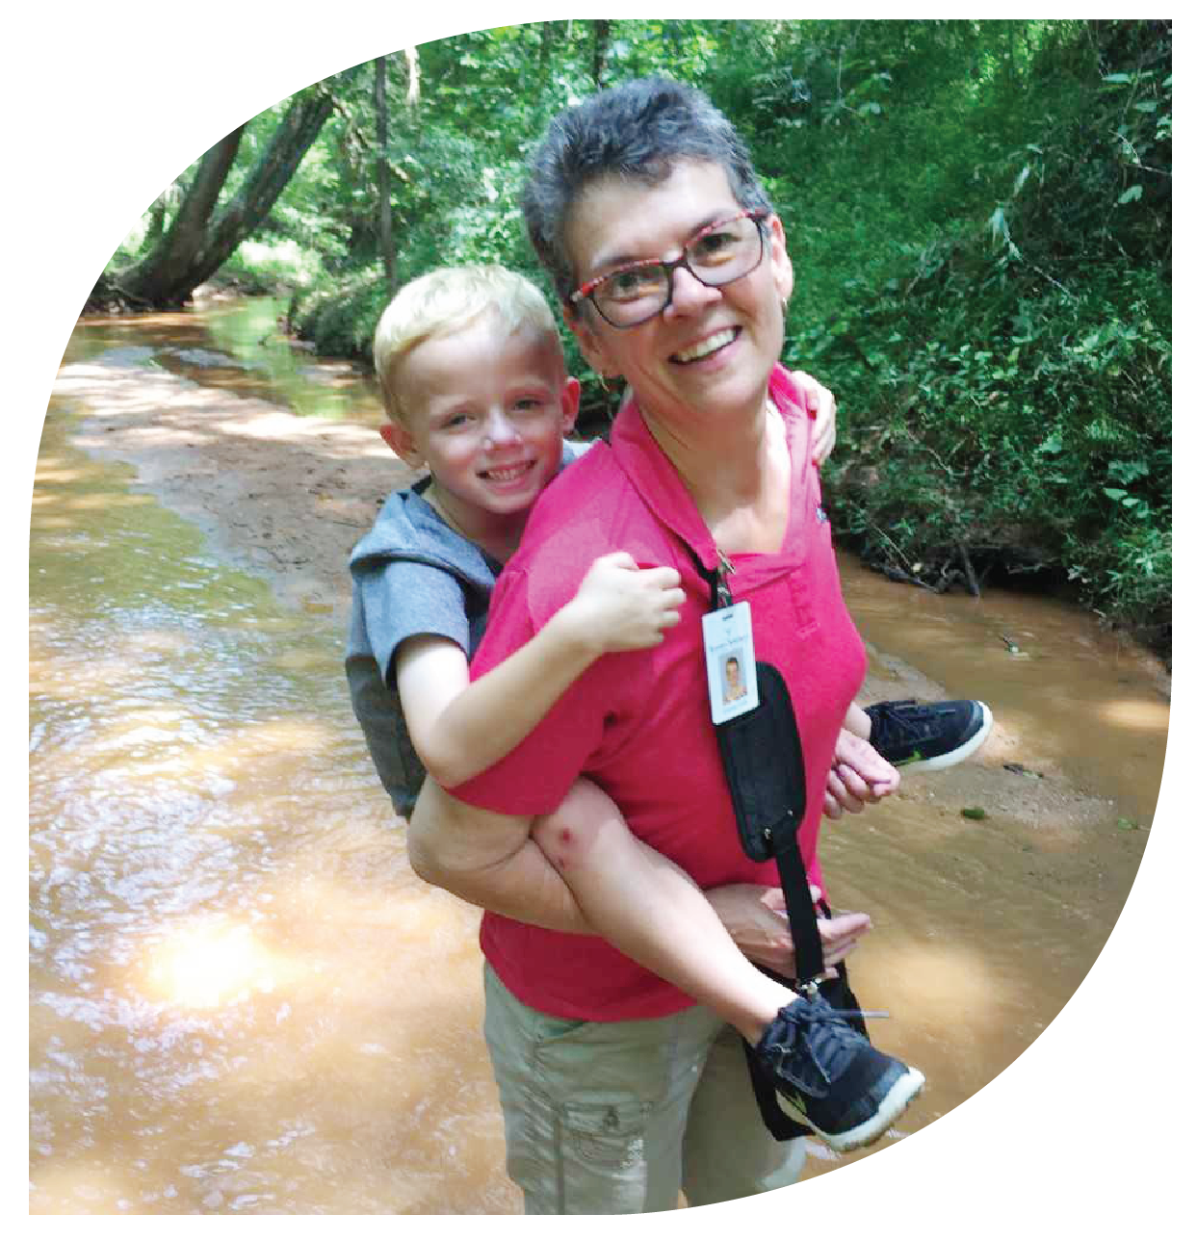
As a formal educator, being able to model the facilitators at different workshops and educational experiences has improved
my lesson planning and
delivery. The opportunity to
visit so many parts of the
state and network with other
educators was also valuable.
Diane folk
Horizons Unlimited/
Rowan-Salisbury Schools

Slide 26
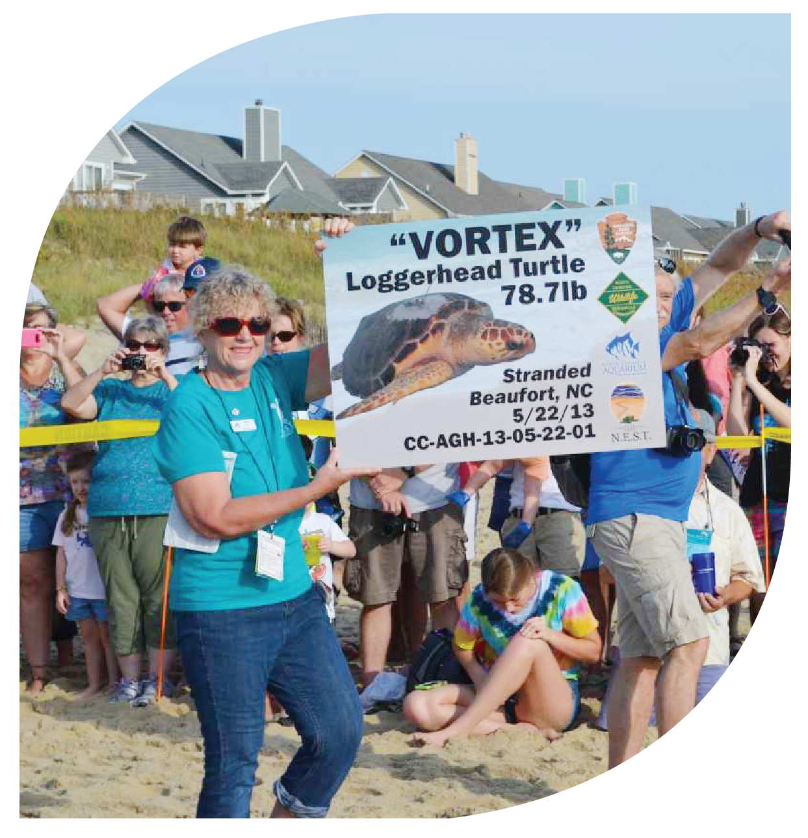
It has been very interesting and gratifying to help educate the public on our native plants and to care for and then release turtles back to the ocean. Both
activities are opportunities to teach the public. I enjoy
raising awareness and appreciation of nature.
The certification program has helped me do this.
Alice Elaine mckeown
North Carolina Aquarium on
Roanoke Island

Slide 27
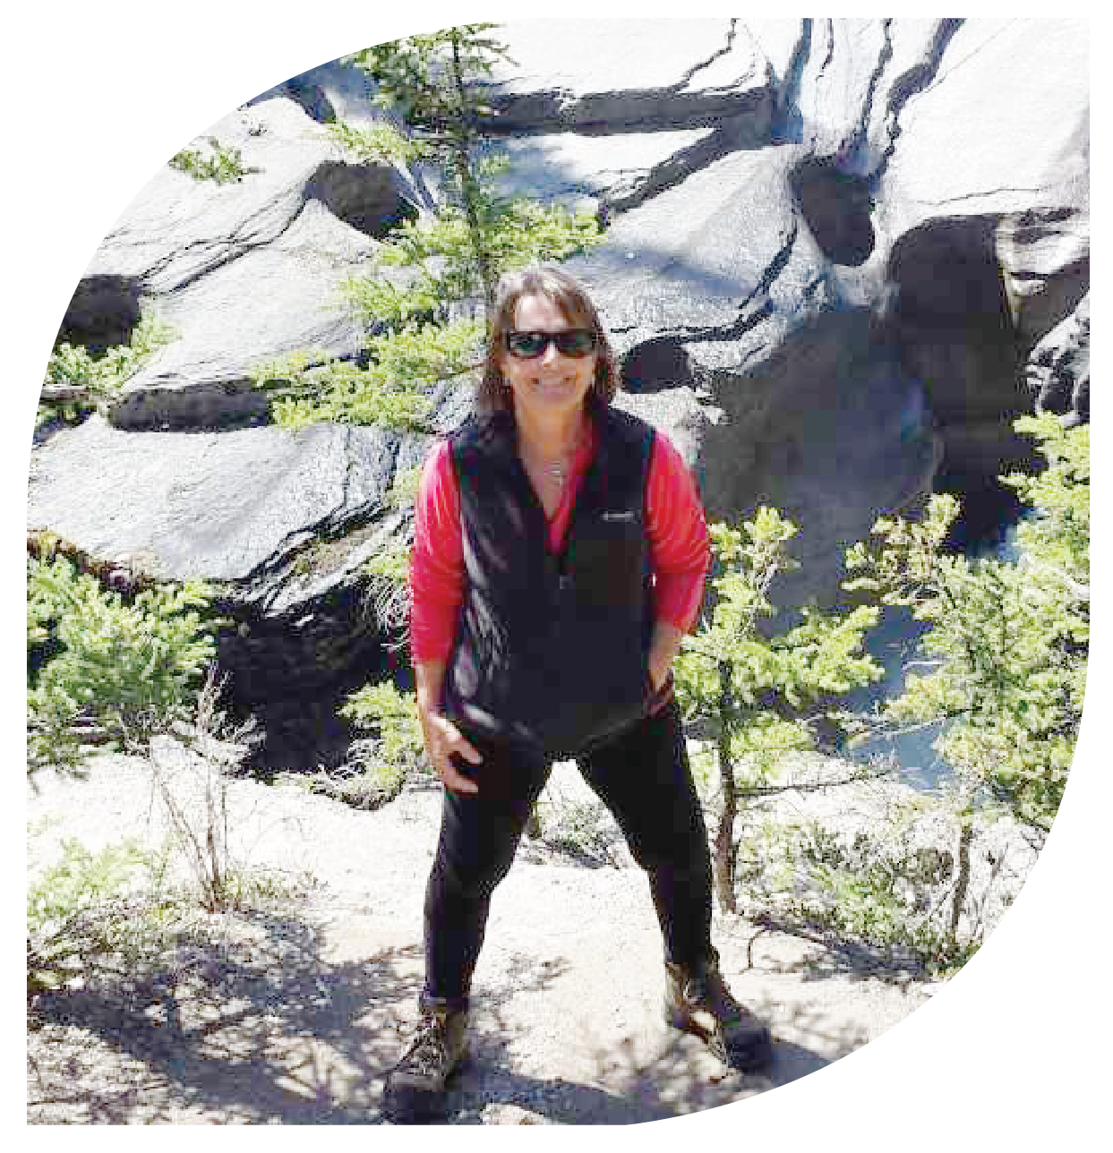
Traveling from the mountains to the sea attending certification programs and site visits was the best! Interacting with formal and
informal educators during workshops and site visits provided a solid background to launch a second career in nonformal environmental education.
Karen dunn
Carolina Ocean Studies

Slide 28
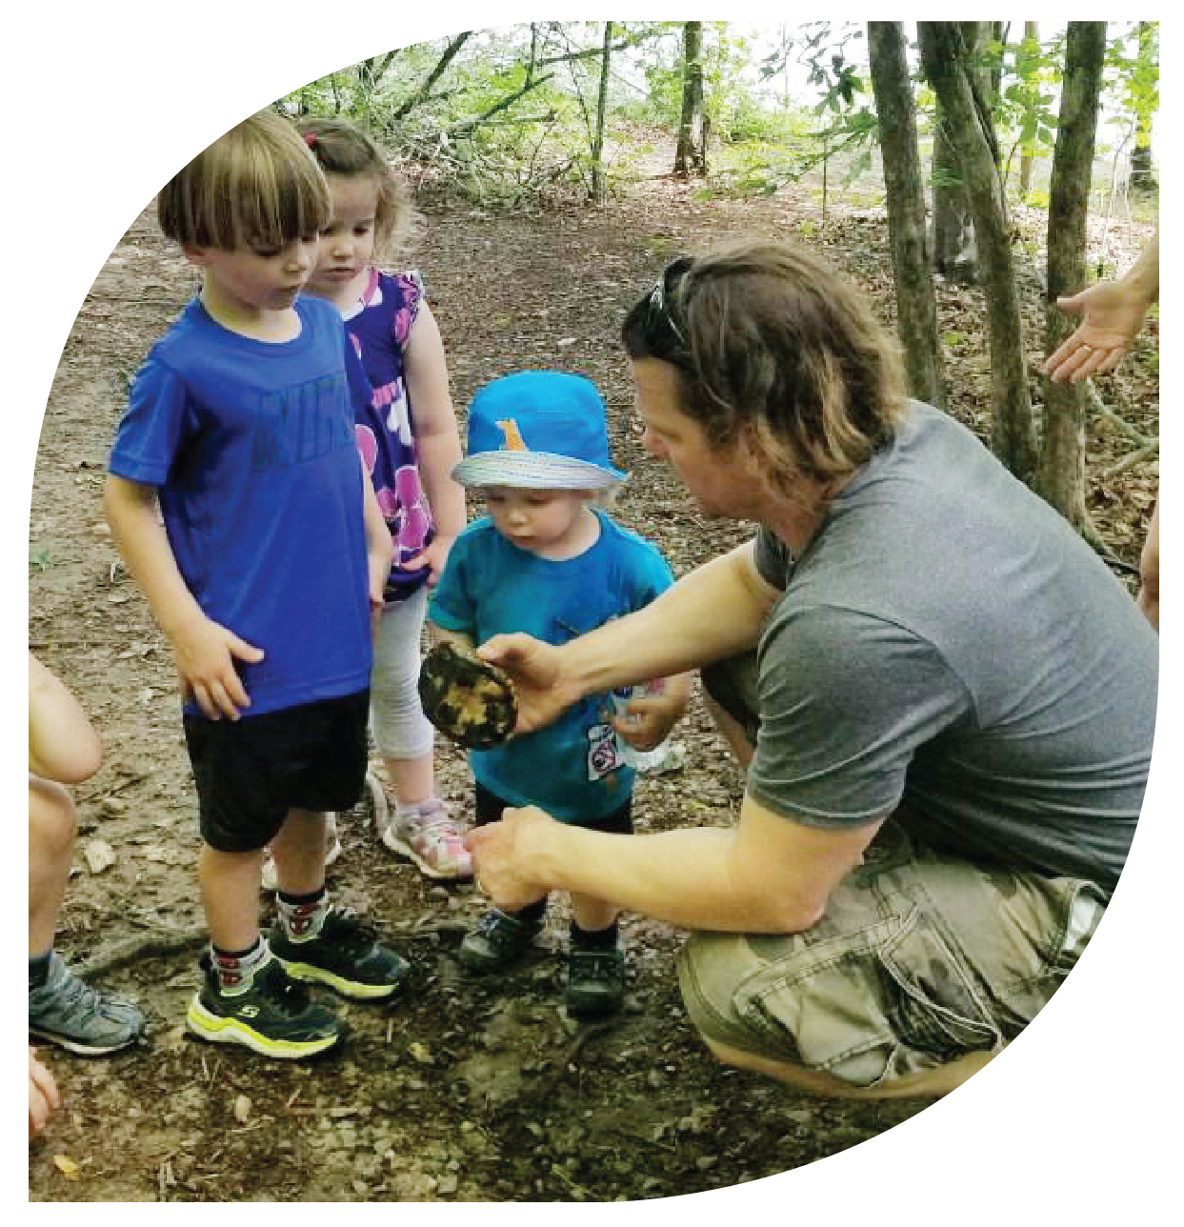
This journey has been remarkably rewarding on so many levels, not the least of which was meeting all the wonderful educators
at the various workshops
and classes.
Ben wittenberg
Wake County Parks,
Recreation & Open Space

Slide 29
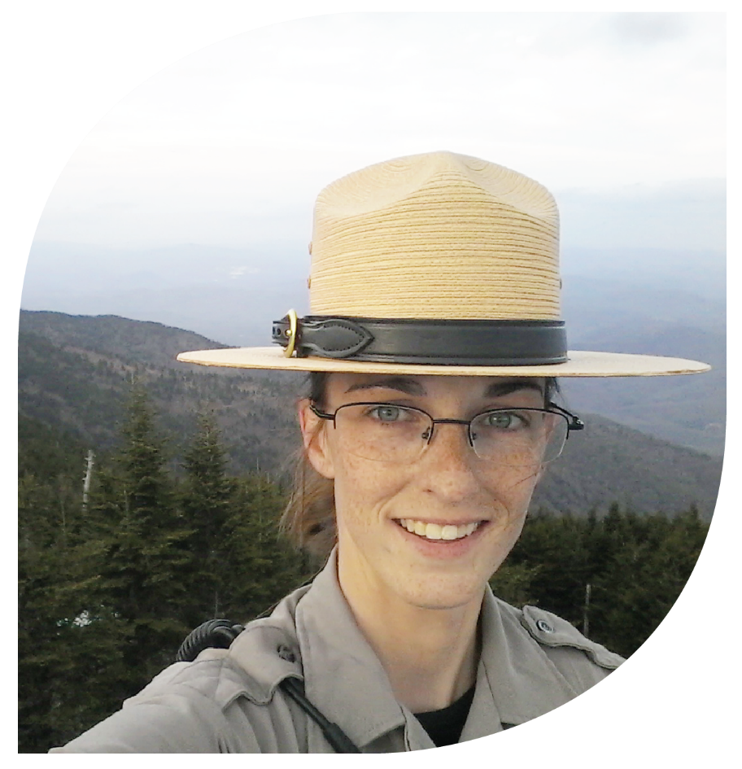
The various workshops
allowed me to meet
many educators
across the state.
Carla williams
Mount Mitchell State Park

Slide 30
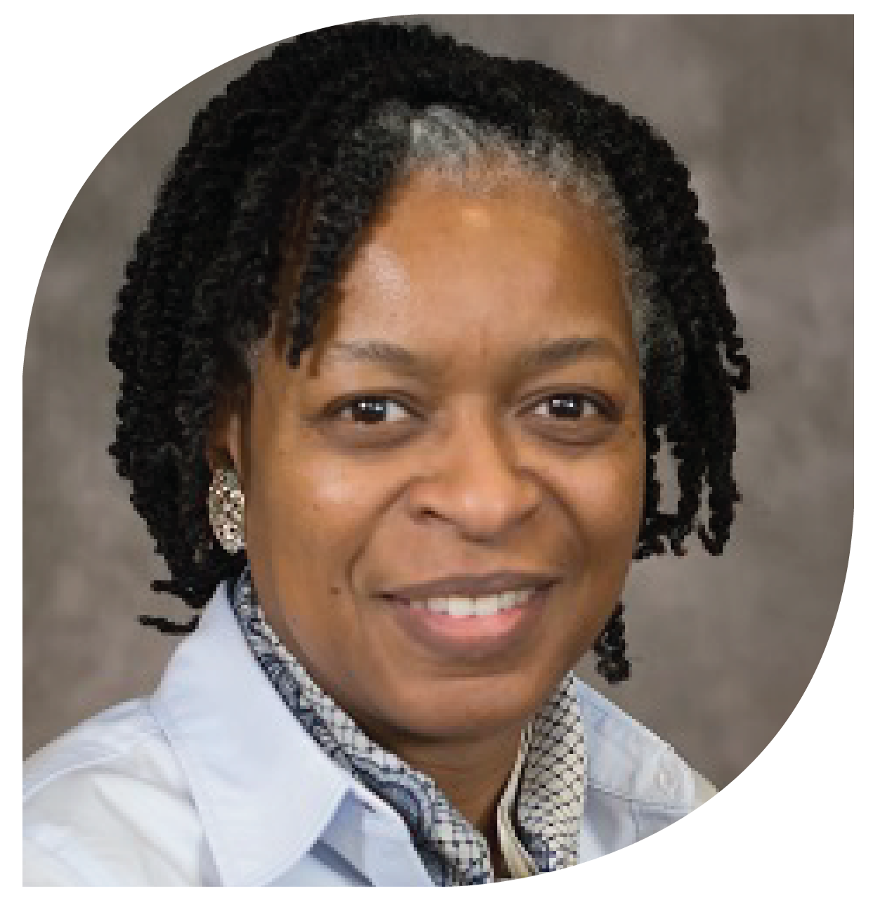
The program allowed me to have the opportunity to take various workshops taught by some of the most knowledgeable
and vibrant formal and
non-formal educators
in North Carolina.
Anganette byrd
Mecklenburg Soil and Water Conservation District

Slide 31
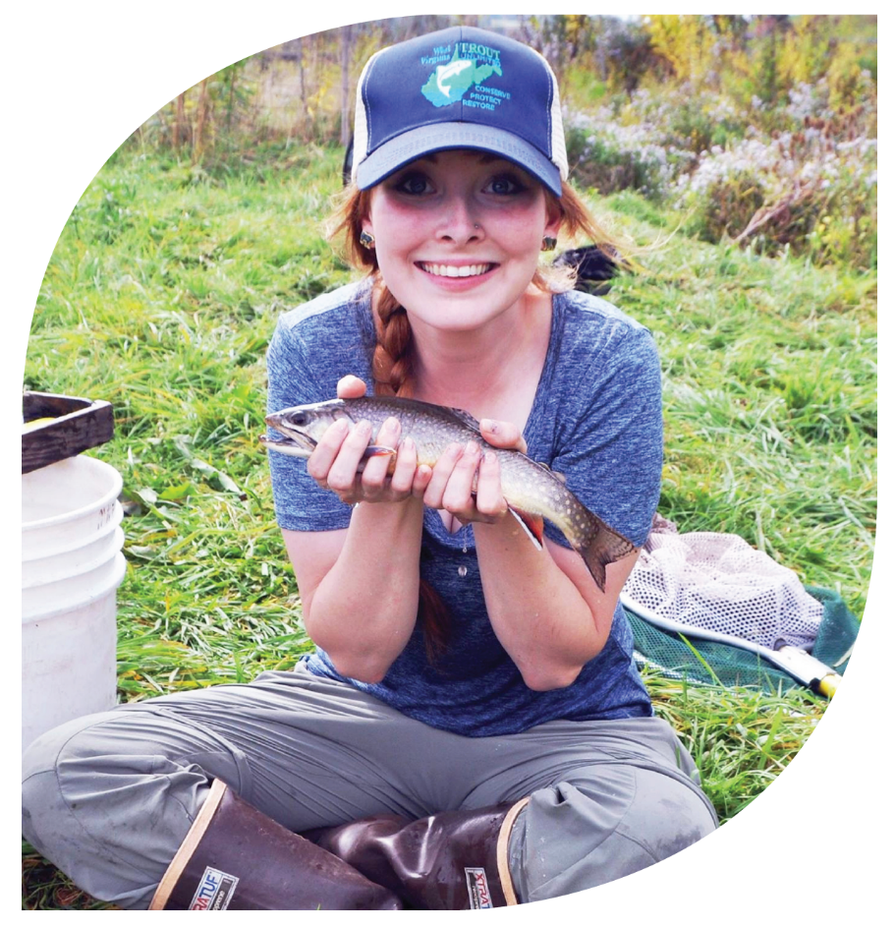
The certification program catapulted me into a world of quality teaching resources
for place-based, discovery-based environmental
education for students
K through gray. I could not
be prouder to call myself
a Certified North Carolina
Environmental Educator.
Mandy nix
Stroud Water Research Center

Slide 32
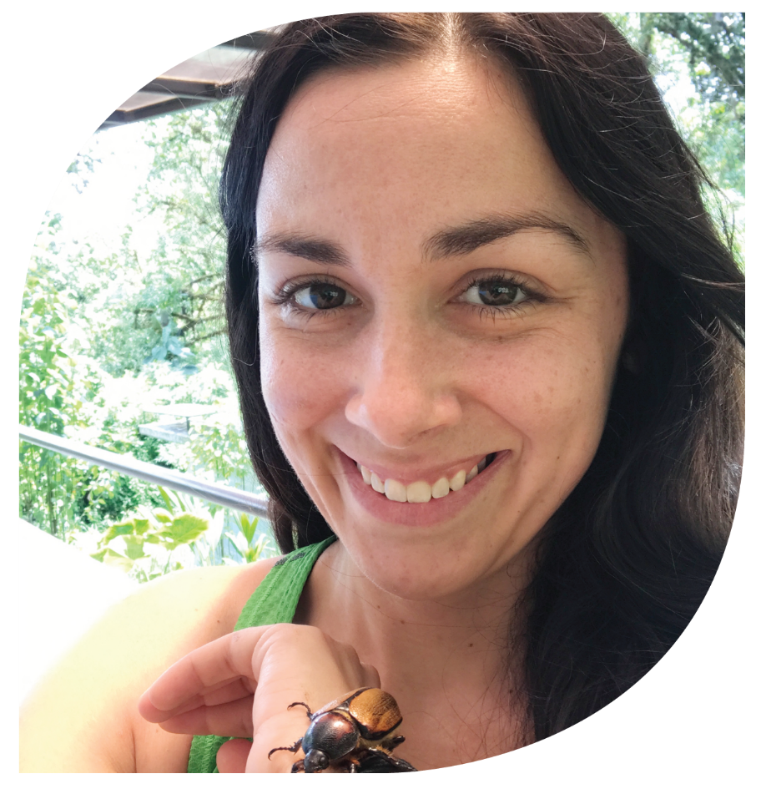
The Environmental Education Certification Program was not only a ton of fun, but also equipped me with the
tools and networking possibilities I needed
to gain advancement in
my career.
Ashley martin
Crowder County Park &
Historic Yates Mill County Park

Slide 33
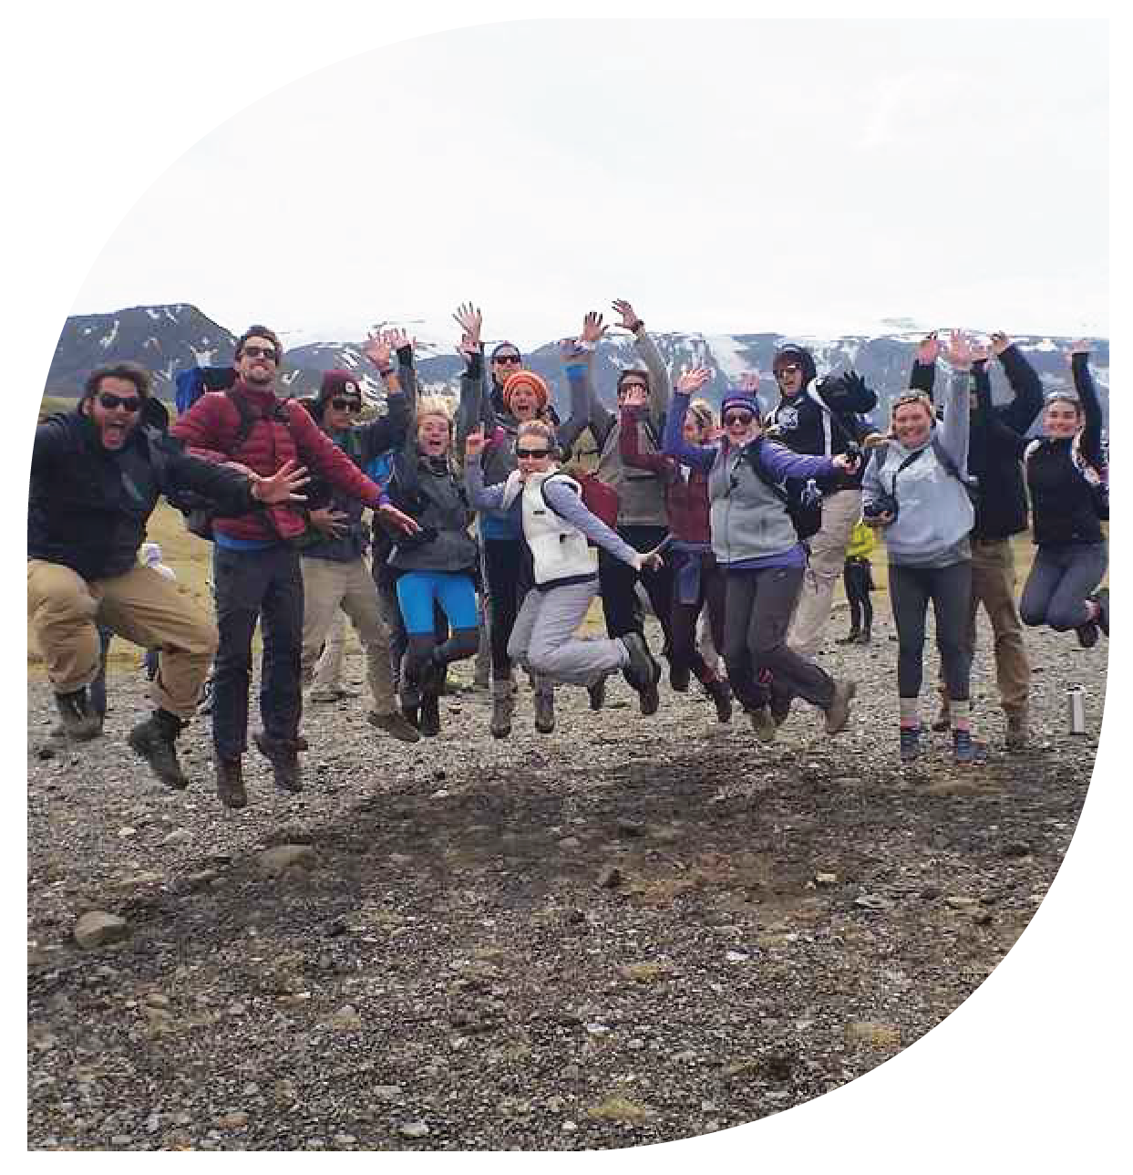
My favorite part of the certification program is the
fact that we are required to
cover all three regions:
mountains, piedmont and
coastal plains. Because of
this, I was granted the opportunity to travel
all over North Carolina to learn more about
these ecosystems and spend wonderful days or weekends immersed in them!
Amy long
UNC Wilmington

Slide 34
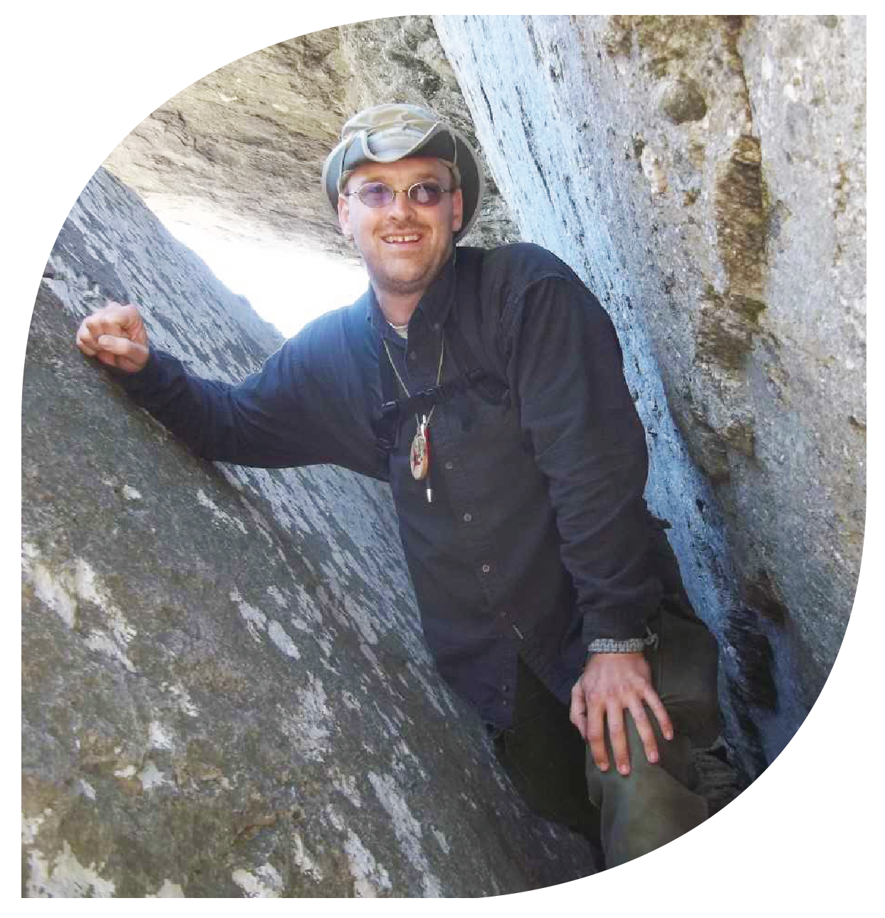
The program helped me become a better presenter and allowed me to see many different styles of teaching. I enjoyed exploring the other
environmental education
centers and different
programs I might not
have seen otherwise.
Andrew snyder
North Carolina Forest Service

Slide 35
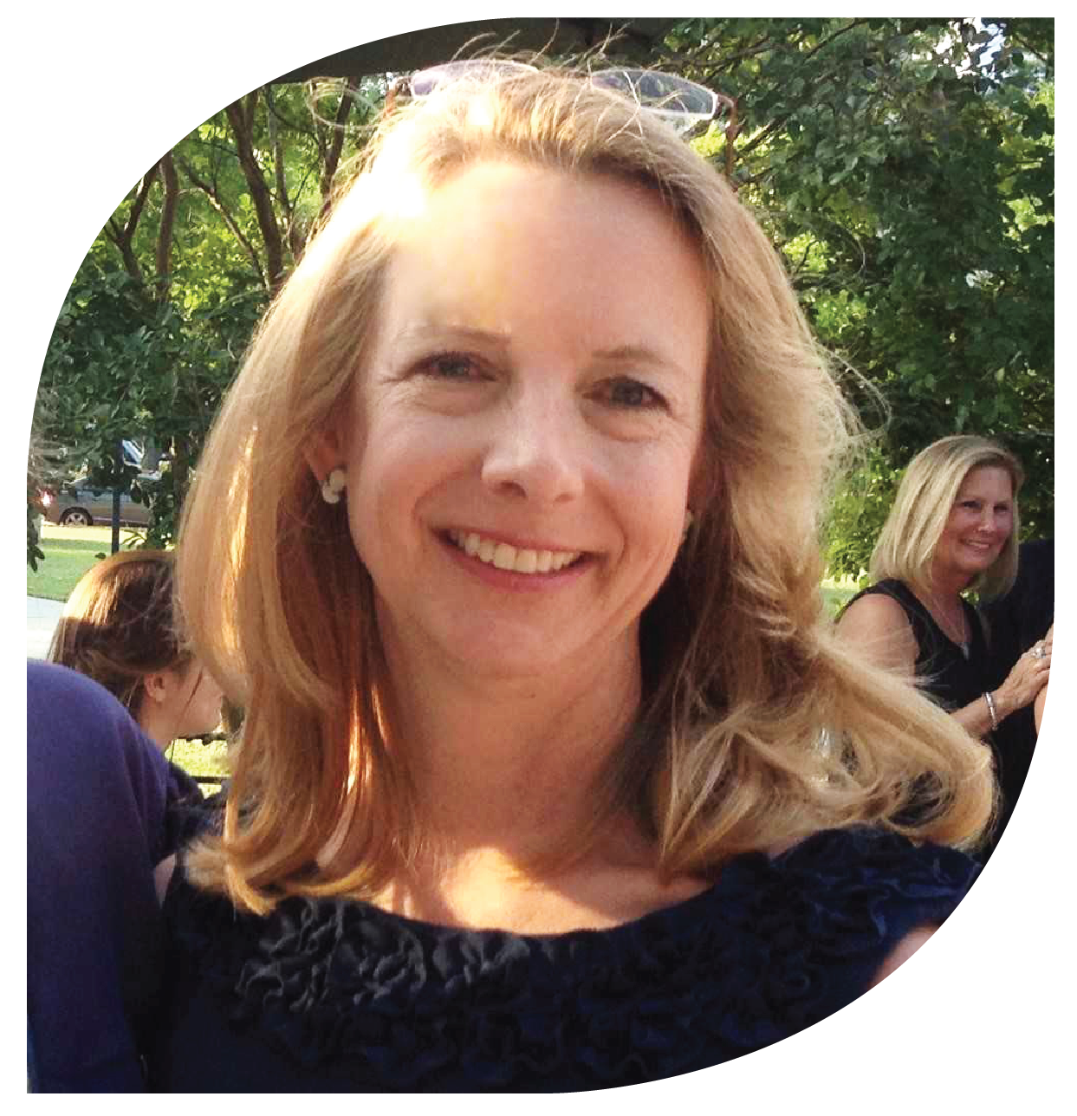
I truly enjoyed the camaraderie of the students who participated in the certification courses. The students represent many backgrounds, professions, and personalities, but the common
goal of increasing environmental awareness in both children and
adults created a quiet but strong bond between environmental education program participants.
Kay nicholls
Wilkerson Nature Preserve

Slide 36
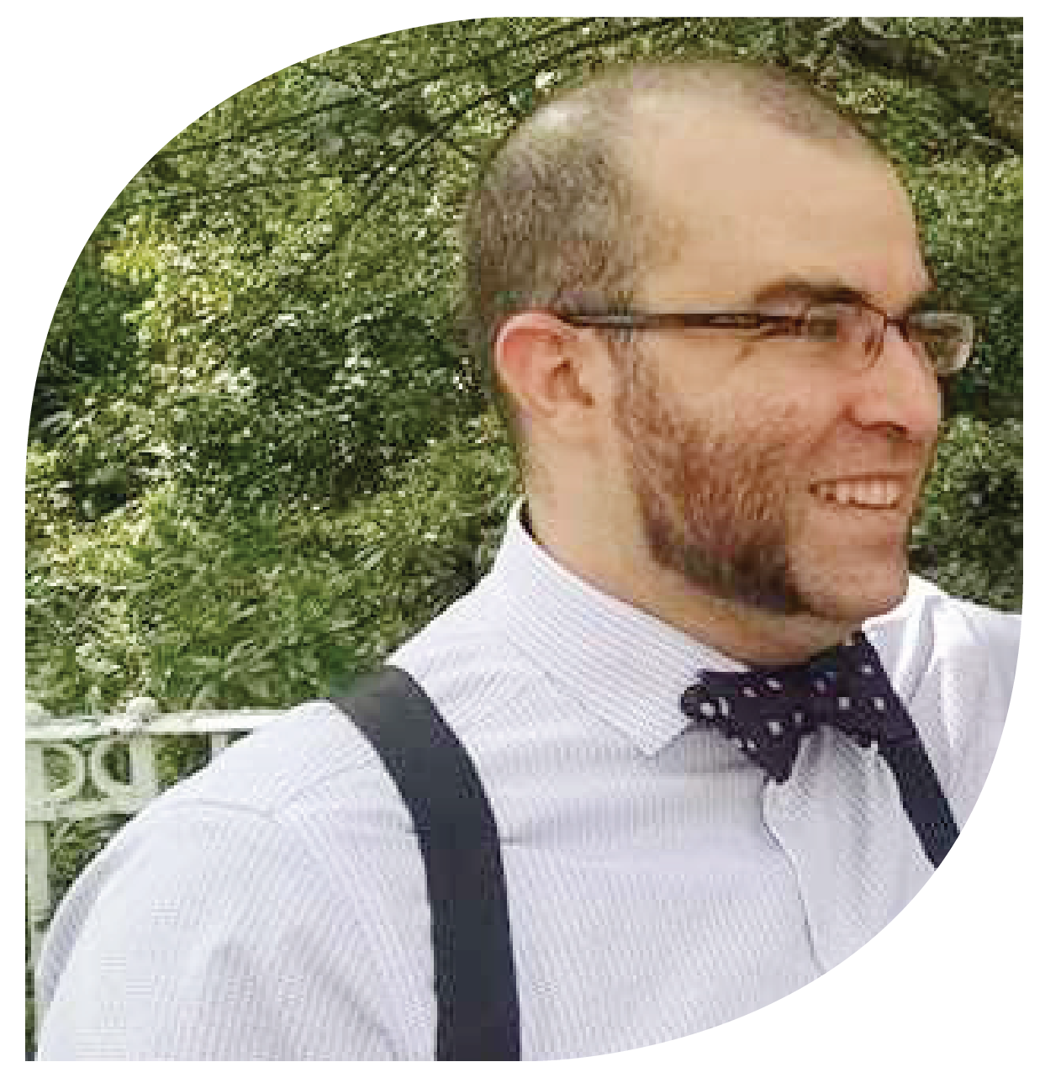
Thank you so much to the certified educators who taught the workshops that allowed me to become one of you! This program really deepened
my appreciation for all
aspects of North
Carolina, its history,
its citizens, and its
natural wonder.
Daniel wheeler
Morehead Planetarium and Science Center

Slide 37
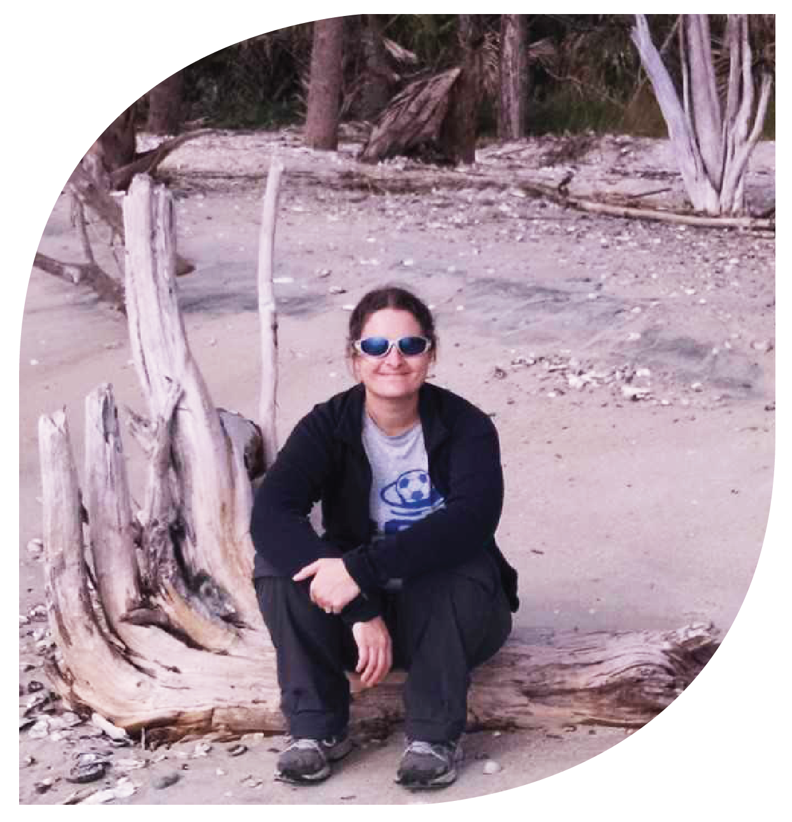
I really enjoyed taking courses that gave me new ideas to incorporate into lessons. Learning what has worked
for other environmental
educators helps us all to be
more effective in our
programming!
April hoyt
Henderson Soil & Water
Conservation District

Slide 38
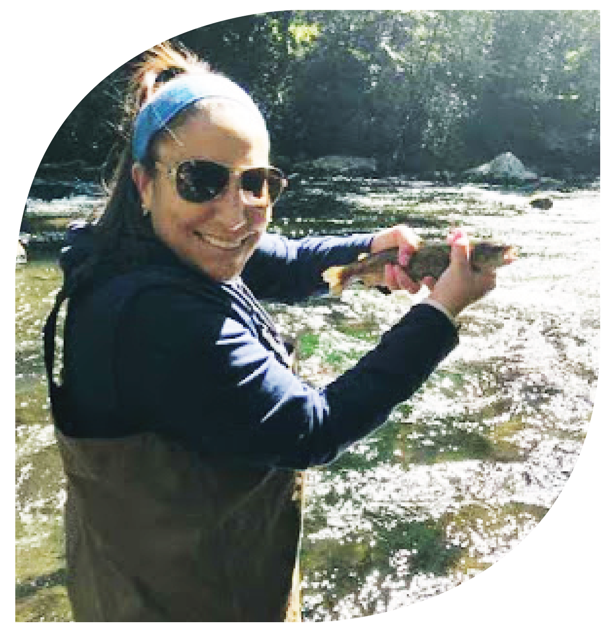
The outdoor experience is always my favorite, but I also enjoyed learning more about how to effectively implement environmental programs. One thing the program
changed about my
curriculum is that I
implemented a nature
journaling component
into our semester work.
Sarah goodman
Providence Day School

Slide 39
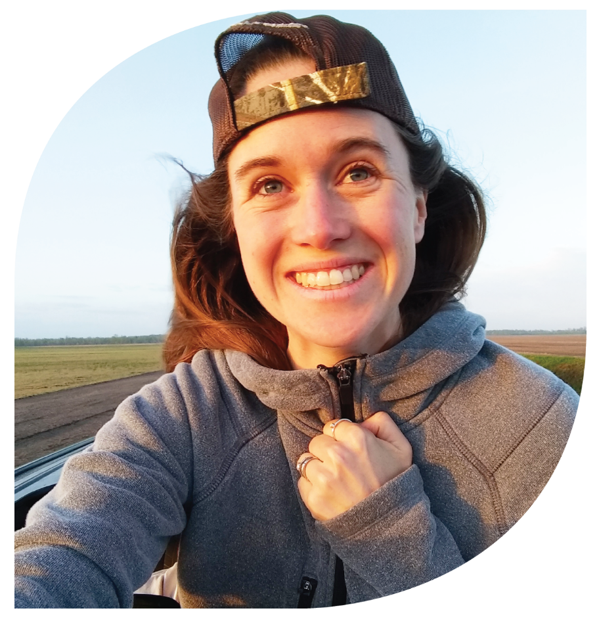
What came out of my decision to enroll was a whole new set of friends, challenging but fun new hobbies,
and, in all honesty, a career
change that I never would have dreamed possible for myself otherwise. This community
has literally changed my
life for the better. Talk about
a program exceeding expectations!
Jenna hartley
NC State University & US EPA

Slide 40
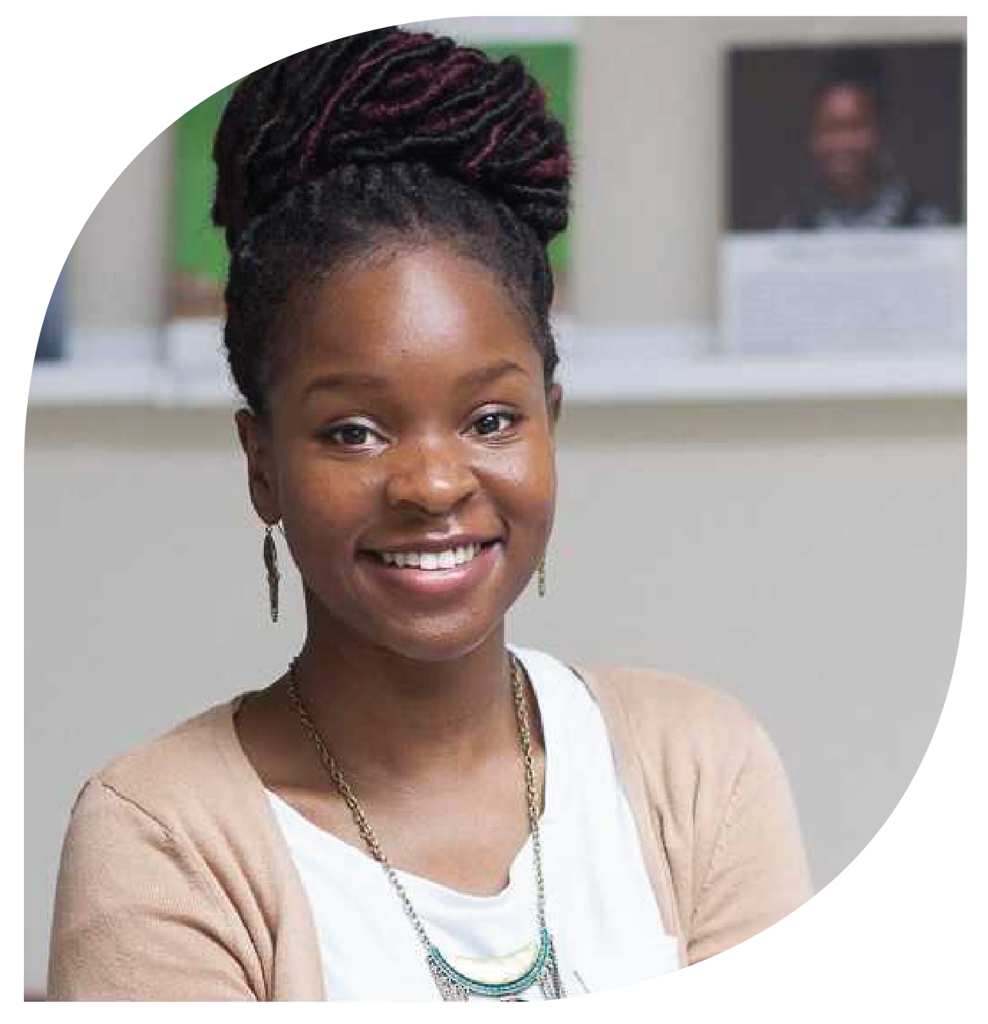
I got the chance to explore so
many places in North Carolina,
learn a great deal about environmental topics I hadn’t
been familiar with before,
and networked my way
into a number of
fruitful opportunities.
I’m very grateful to have
enrolled and completed my certification.
Cynelsa broderick
SEEDS

Slide 41
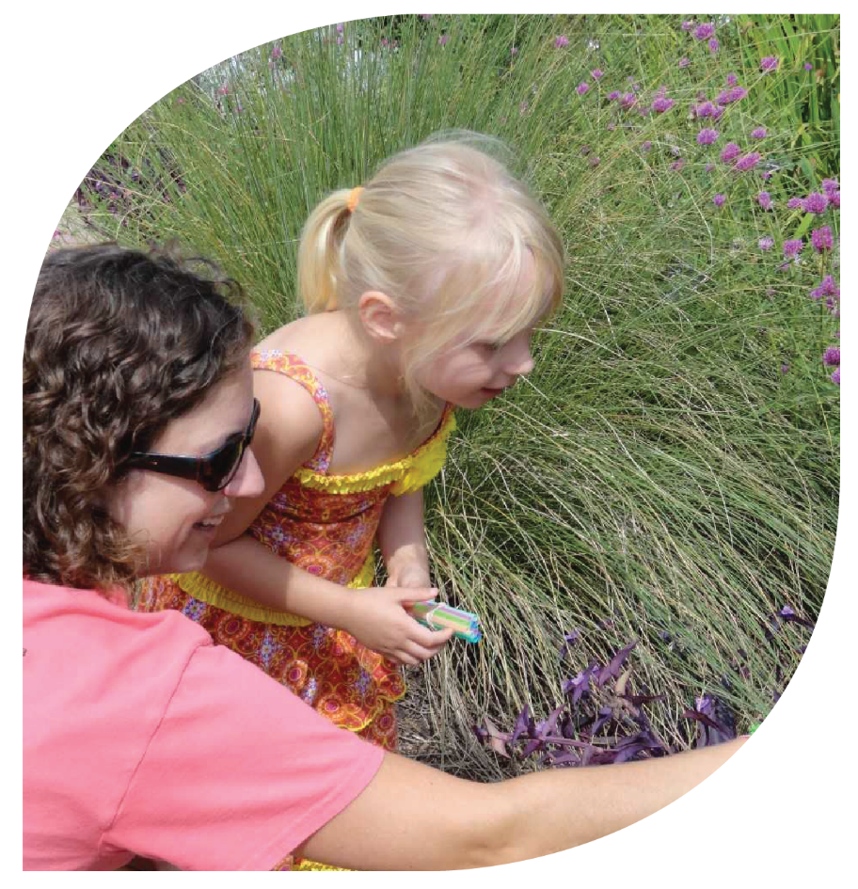
I am so proud to be a Certified Environmental Educator and part of this community in North Carolina.
The certification process
added a depth to my work through the knowledge,
experiences and friendships I
gained in the programs and workshops along my journey.
Elizabeth overcash
JC Raulston Arboretum
at NC State University

Slide 42
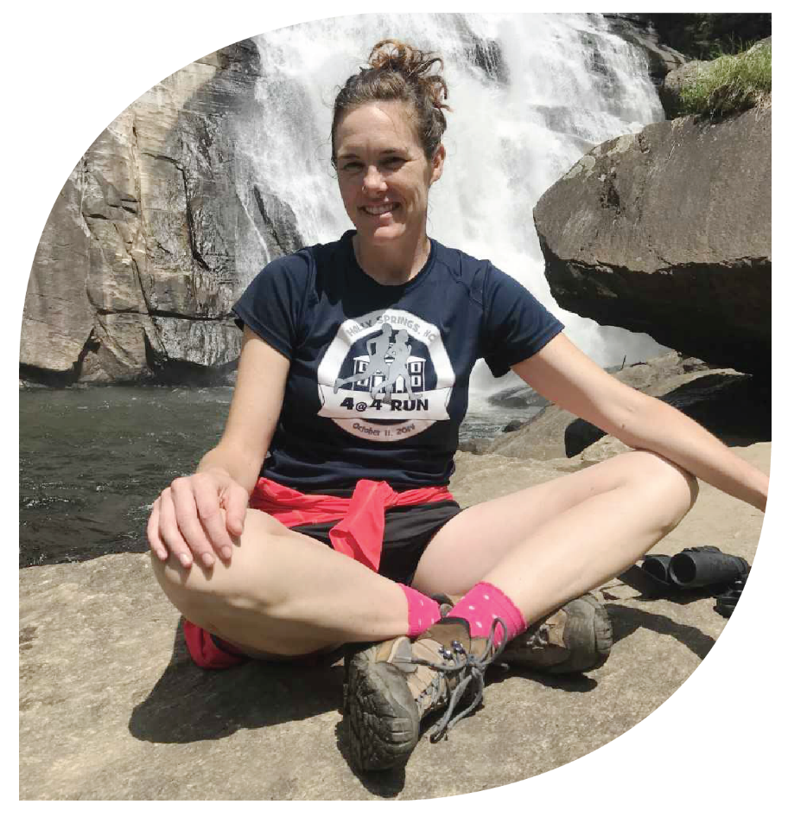
This program made me fall in love with North Carolina. It feels more like home to me now than before I traveled all around,
learning about its rich
resources. Now I get to share
that first hand knowledge
and love with my students!
Rachel woods
Dragonfly Nature Programs LLC

Slide 43
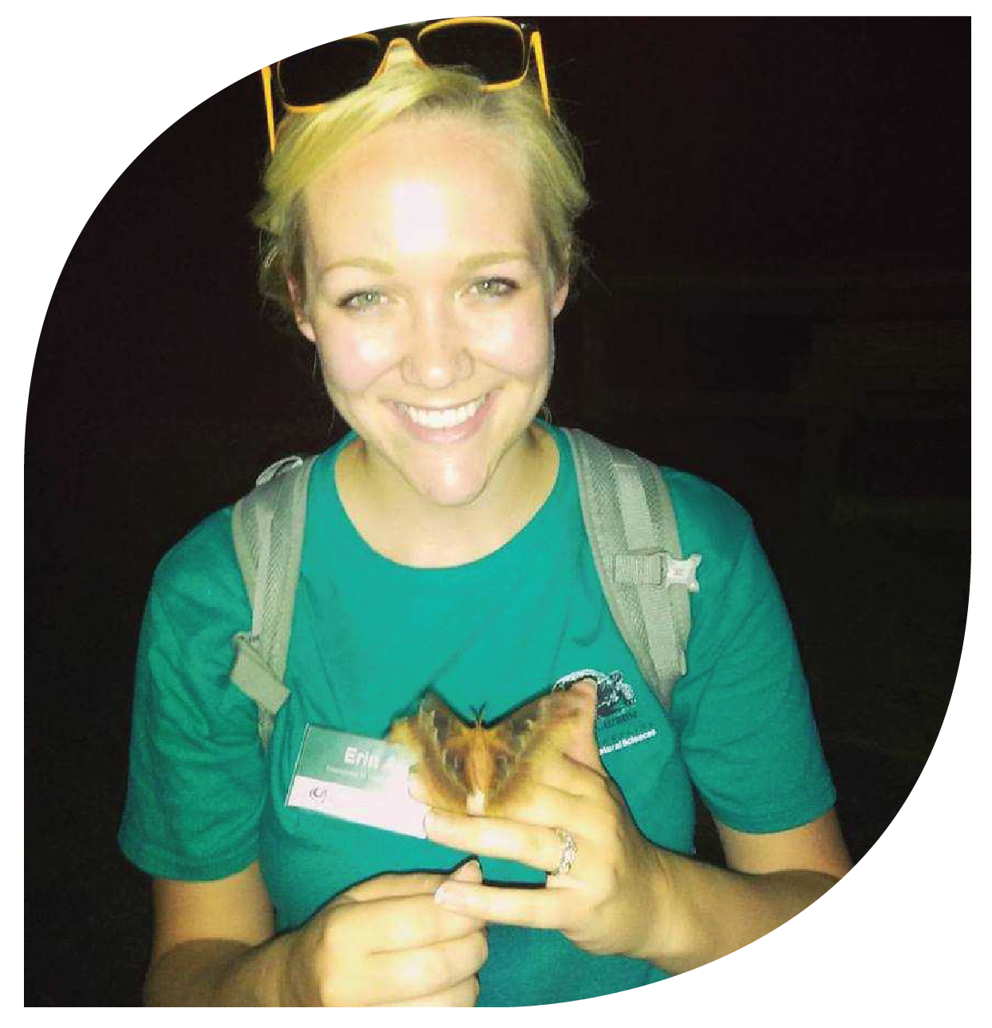
The North Carolina Environmental Education Certification program has been invaluable to me both professionally and personally.
The knowledge and experience
I gathered as an educator and
the connections I made across
the state have helped me tremendously in my career.
Erin apple
NC Museum of Natural Sciences

Slide 44
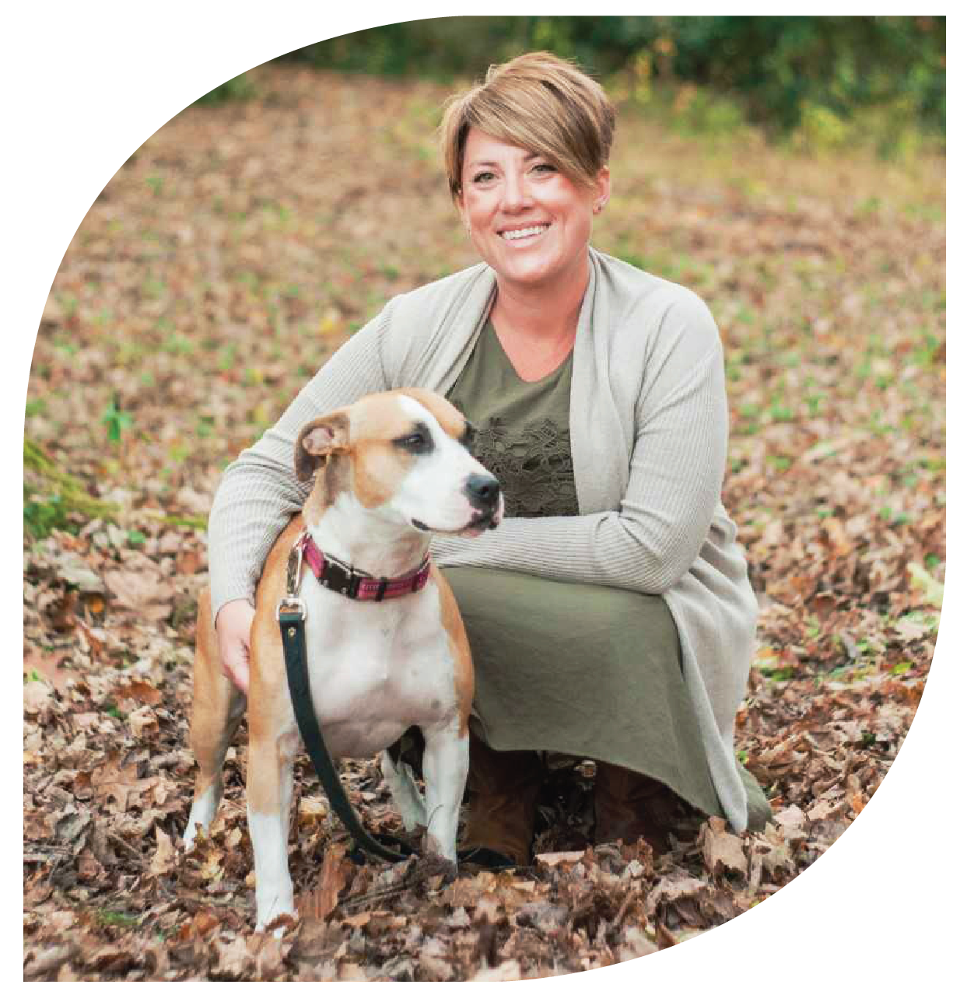
Earning the North Carolina Environmental Education Certification has been one of the most rewarding accomplishments of my life. I
grew as an environmental
educator, met incredible
people, and got to know
North Carolina in a
whole new way.
Jessica janc
Blue Ridge RC&D

Slide 45
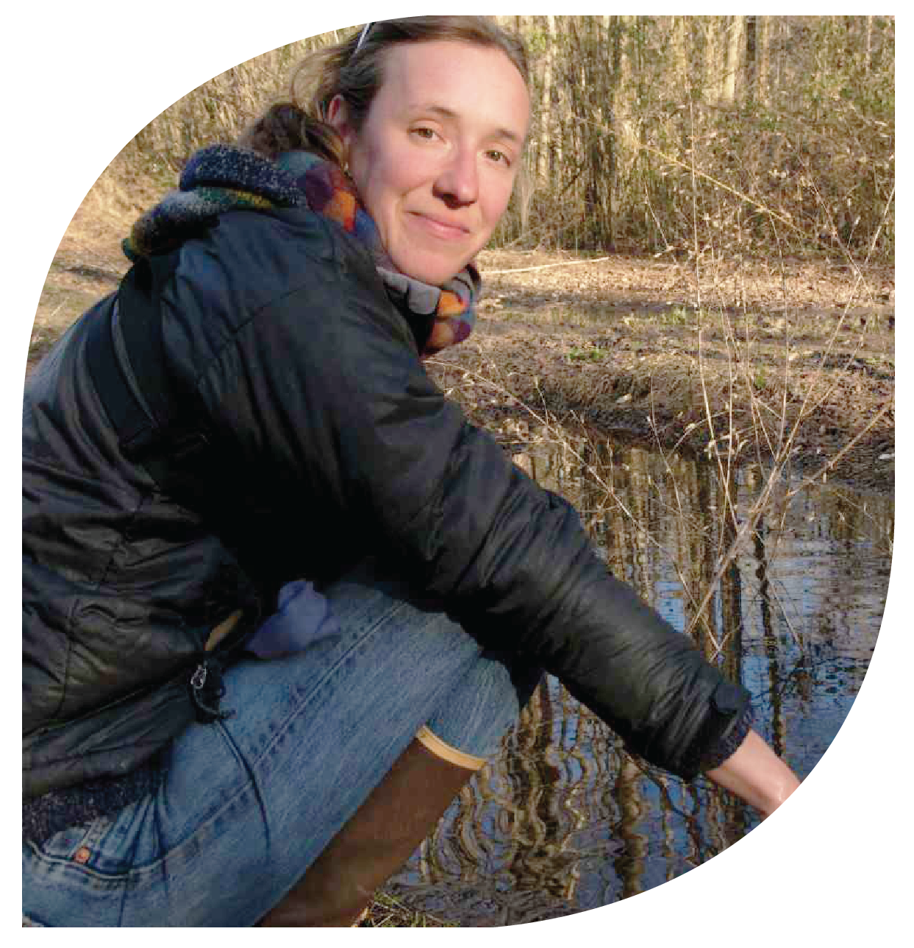
I am very proud to now be able to
call myself a North Carolina Certified Environmental Educator because it highlights the importance and
value of what I truly believe in
as an educator. I am grateful for
the certification process because
it has connected me with a wealth of resources across
the state.
Molly gillespie
Muddy Sneakers

Slide 46
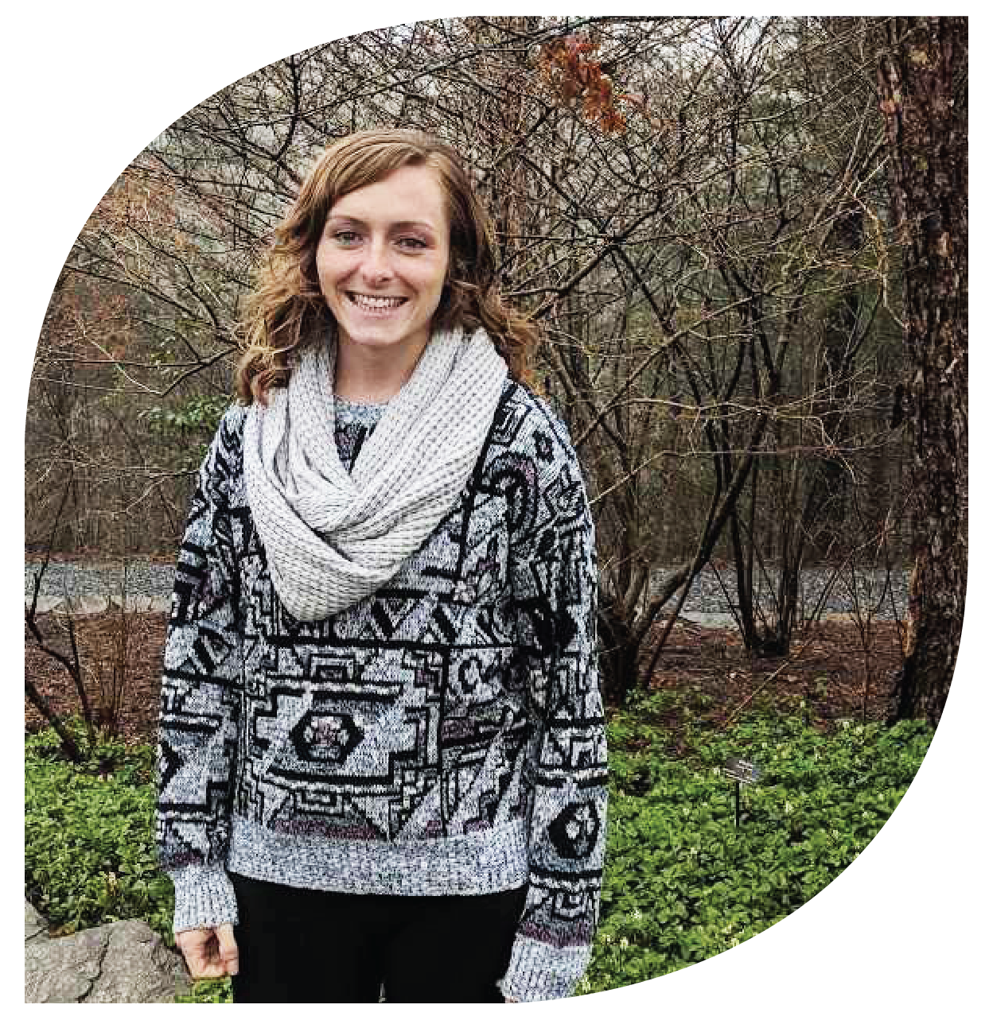
The North Carolina Environmental Education Certification is truly life-changing. It gives you the tools, knowledge, and resources
you need to turn what
you love into a career
and build your network,
all while having a blast and experiencing the beautiful
places North Carolina
has to offer.
Chelsea sloggy
Union County Soil & Water
Conservation District

Slide 47
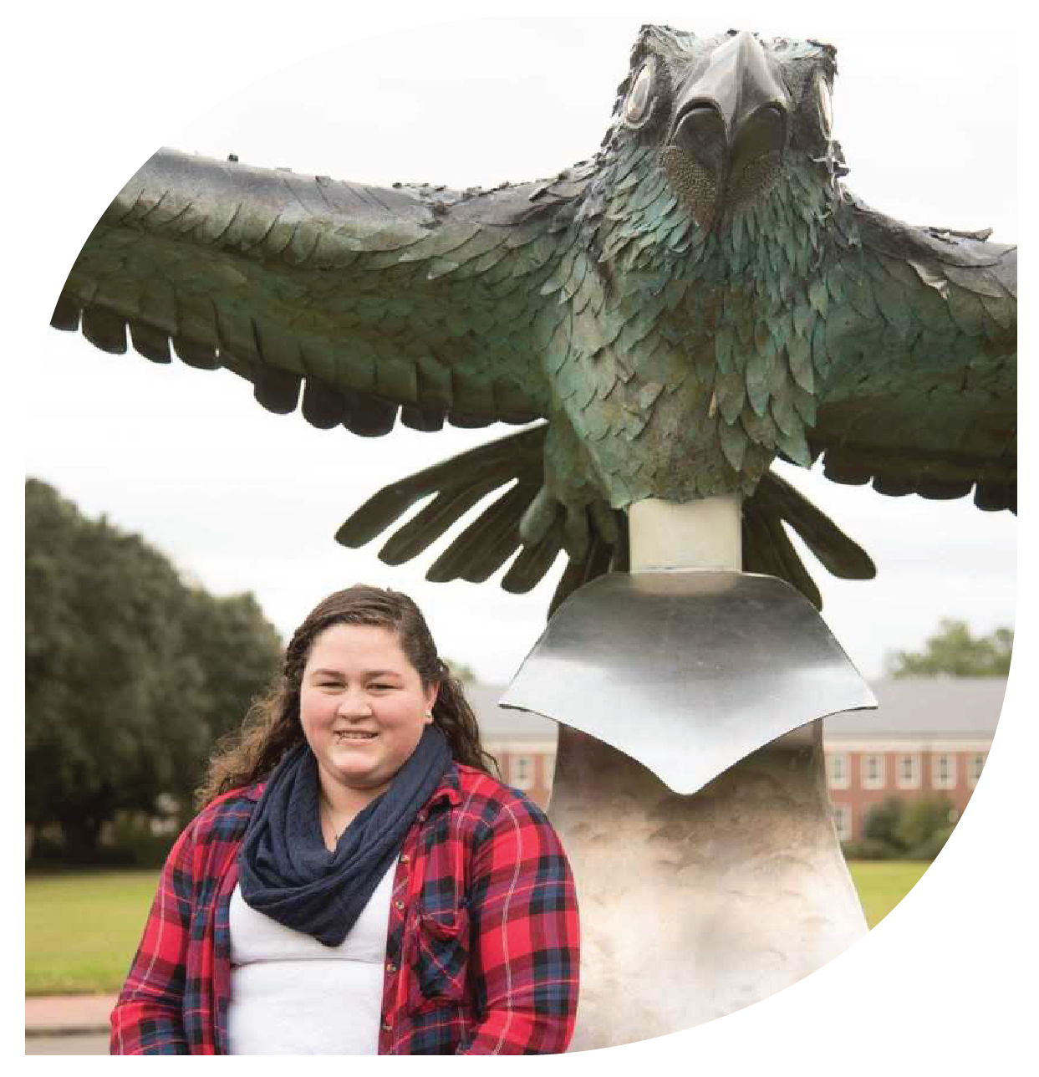
My favorite part of the certification program has been meeting and networking with many like-minded people from all across the state.
Caitlin Williams
University of North Carolina
Wilmington

Slide 48
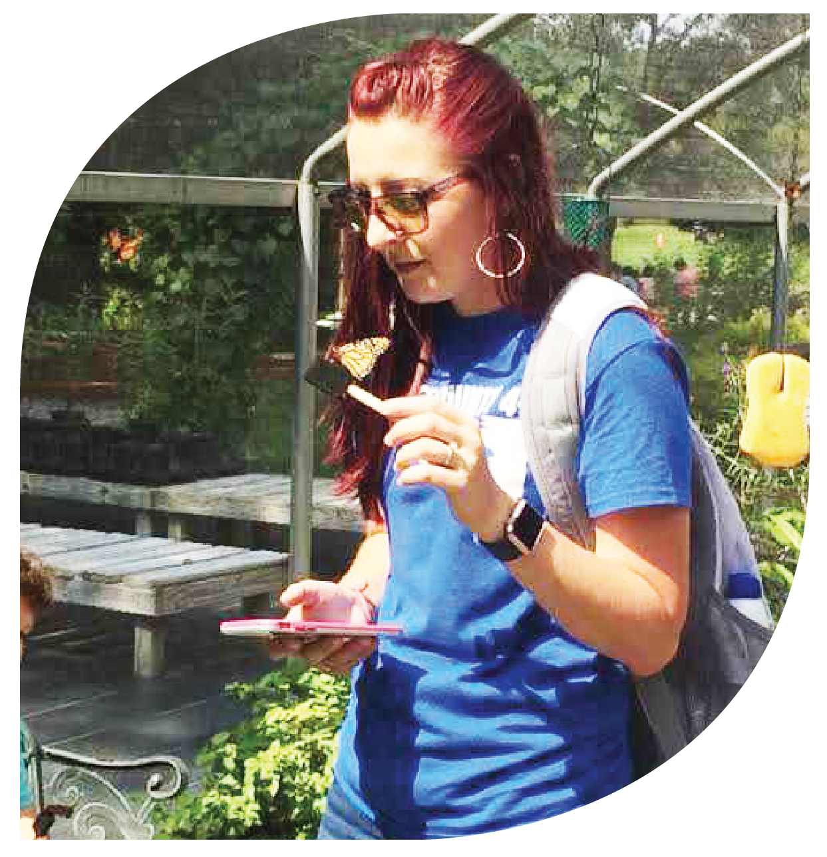
The North Carolina Environmental Education Certification program has allowed me to create a 4-H program that instills
environmental literacy by
fostering observation,
investigation, experimentation,
and innovation.
Whitney greene
Wilkes County Cooperative
Extension

Slide 49
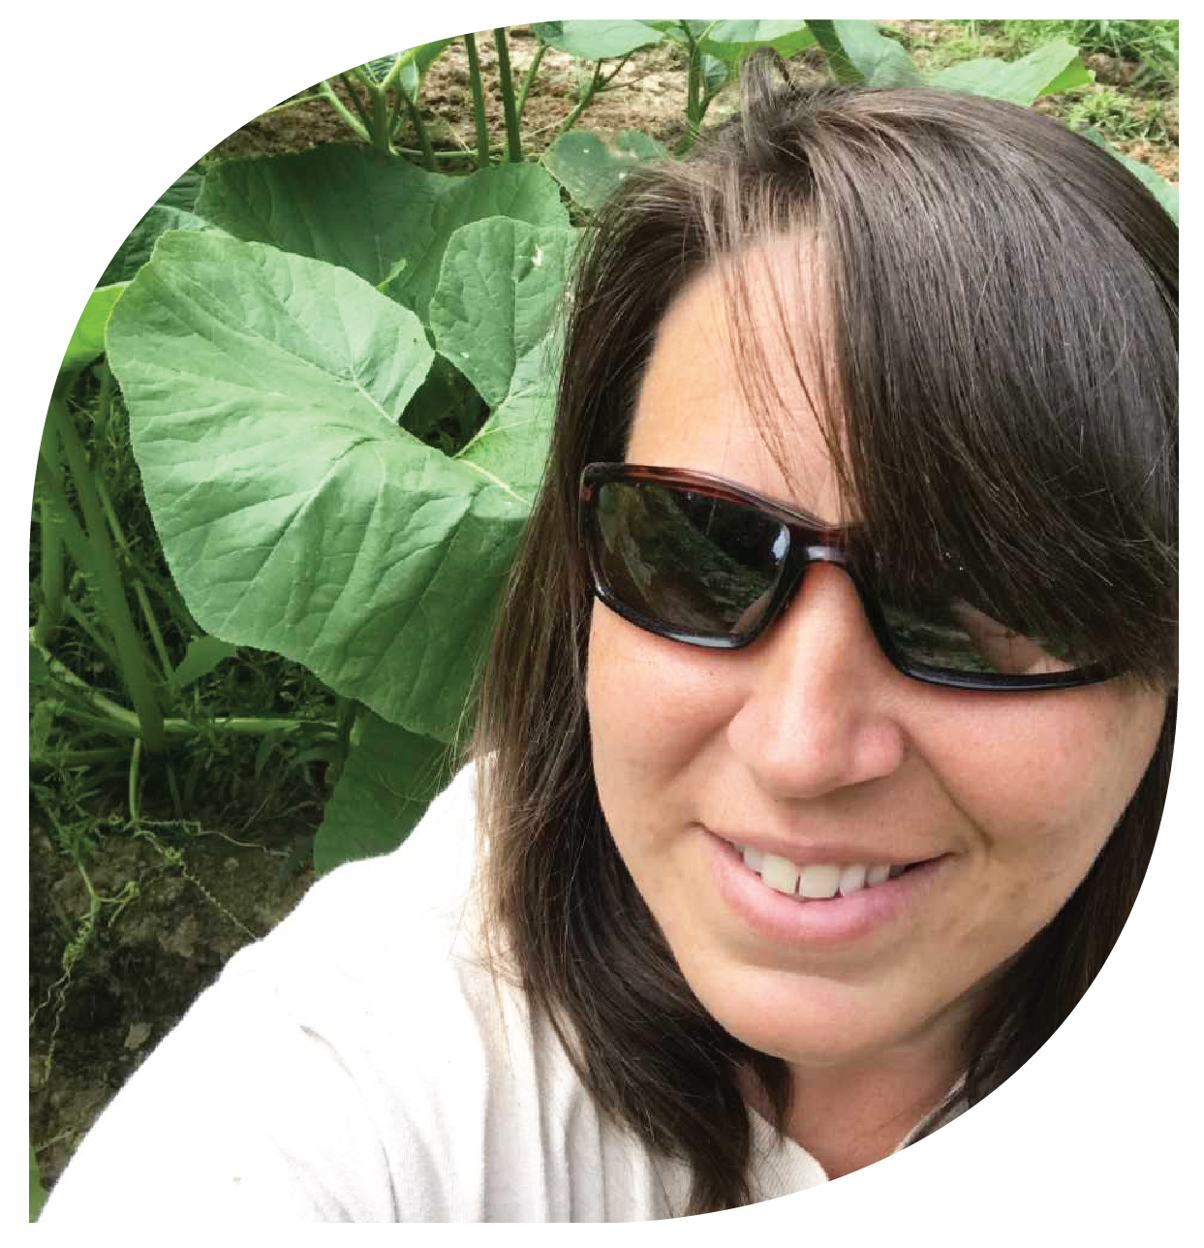
During my experience I have learned new ways of sharing
my passion for the great outdoors with others. I
am thankful for this
opportunity to share
environmental education
with the students and visitors
at Jordan Lake Educational
State Forest.
Carla hunt
North Carolina Forest Service

Slide 50

My favorite thing was working on my Tree ID project and talking with park patrons as I studied the trees and took pictures of them.
Each person I talked with
asked different questions
and expressed both interest
and excitement for the project.
Janet harrison
Town of Cary Parks and Recreation

Slide 51

My favorite part of the program was traveling to all of the beautiful places around the state where the workshops were held and the sheer joy of discovery as I moved through the program. It brought back all the excitement
I used to experience when I was
a child playing in the woods.
Julia Alison-soto
Girl Scouts

Slide 52

Obtaining my certification
was a valuable experience for me because I expanded my knowledge of North Carolina ecosystems, learned new activities to
teach and different methods
of teaching them, and
became friends with
other educators in the
field. It was truly a
wonderful experience!
Tara whicker
Fort Caswell

Slide 53

The environmental education certification program has allowed
me to make valuable connections
with fellow environmental
educators, obtain essential skills
in the field and gain access to
resources; all of which I utilize
often in my programming and
summer camp on Beech
Mountain!
Marisa sedlak
Beech Mountain Parks and Recreation

Slide 54

I enjoy the continuing education opportunities because it’s a fun gathering for educators to play outside, sharpen our
environmental education
skills, and share ideas and
experiences that may
enrich each others’
programs.
Misty varnell
N.C. Cooperative Extension,
Edgecombe County Center

Slide 55

The certificate program redefined the way I will use my
leadership and teaching
skill set. I became more
engaged and participated
in more action oriented
community programs that
bring about awareness
and education for
North Carolinians.
Molly nelms
Self-Employed

Slide 56

I could not have hoped for more insightful workshops, skill-building opportunities, or interdisciplinary collaboration through this
program. Not only did I
glean practical skills and
knowledge, but the
confidence I found in
myself now allows me
to mentor others in
the field.
Bethany sheffer
HIGHTS, Inc.

Slide 57

I learned a lot about inquiry-
based teaching, group facilitation, and group management while teaching
in the field. I enjoyed the
diversity of workshops and
getting to meet a diversity of
instructors, educators and
others who I might otherwise
never have run into.
Gretchen stokes
Graduate Research Fellow

Slide 58

My favorite part of earning my certification was working on my community partnership project
as it involved a combination of several things I like to do,
including creating new nature
guides, designing datasheets,
getting people involved in citizen science, and teaching people about insects.
Chris goforth
NC Museum of Natural Sciences

Slide 59

Before this program, I didn’t give myself enough opportunities to teach. I believe I now have
a broader understanding
of how to approach and
learn about environmental issues. I pay more attention
to species, habitats, and
changes happening in our environment.
Leah farr
Jordan Lake State Recreational Area

Slide 60

I have been teaching lessons outdoors for over 20 years but by completing the environmental education certification
program I have a more structured idea of how
to package and direct
these lessons on the key characteristics of
environmental education.
Amy taylor
University of North Carolina Wilmington

Slide 61

Earning my certification has allowed me to network with other educators, learn new teaching skills, and gain more knowledge
of the environment in North
Carolina. My favorite experience
was finding a crown snake during
a reptile workshop!
Kristin gibson
Fulbright Austria

Slide 62

My favorite part of earning my certification was working with the students during my
community project. It
was great building the pine
cone bird feeders with them
and seeing how interested
they were in birds.
April boggs
The Nature Conservancy

Slide 63

I loved the certification program because it gave me the perfect job. I love teaching, but I wanted to be outside the classroom. I was driven to complete the whole certification in a few months and was able to make my dream a reality.
Paula Smrcina
Wild About Nature

Slide 64

Obtaining my certificate has helped me become more aware of the resources and able to articulate why those resources are important, and that they are available to all. The program continues to
be a source of great colleagues and collaborators for future programs. Environmental educators are the best!
Megan chesser davis
NC Museum of Natural Sciences

Slide 65

This program is a credit to the state of North Carolina. Everything I’ve learned I’ve tried to incorporate
into my eco-tours. I meet people from all over the country and
the world who have different interests. This program has allowed me to reach and educate a broader group
of people.
James moore
Outer Banks Adventures

Slide 66

The environmental education certification program helped me to learn, grow and refine my skills and understanding
on how to better connect children to nature.
Cathleen Reas
The Nature Conservancy

Slide 67

I’ve learned to think about formal and informal education experiences in different ways. I’ve also learned how to remove obstacles to participating in environmental education not just for students, but for teachers as well.
Aaron sebens
Central Park School for Children

Slide 68

Through the certification program, I met lots of other professionals from a wide array of backgrounds. Hearing their points of view made me think about or pay attention to
issues that I normally don’t
think about. It also taught
me to be a better listener
in order to be a better teacher.
Lynn lambert
Harnett Soil and Water
Conservation District

Slide 69

Participating in the certification program has helped me become a more engaging, interactive educator. Learning about
methods and best practices in environmental education and applying these principles to my teaching has resulted in more impactful, memorable programs
for my audiences.
Marissa blackburn
North Carolina Aquarium at Fort Fisher

